Slide 1
Syracuse
Trailblazers
April 24
2019

Slide 2
Connecting
Trailblazer Community Groups: Syracuse, NY Developers Group
How we track membership, schedule meetings and RSVP to upcoming events
Twitter: @syracusedevs
Posting formal meetups, informal gatherings, retweeting regional events and member activities
Chatter: Syracuse, NY Developers Group
Conversations and discussions with other group members
Web: SyracuseDevelopers.com
Links to the above sites, copies of slides/code presented at meetups

Slide 3
Events
Phillyforce - May 6
Philadelphia, PA (4 hour drive)
$76 online, $100 at door
True North Dreamin - July 11-12
Ottowa, Canada (3 hour drive)
Admission: $93 by Apr 30, then $113
www.truenorthdreamin.com
Northeast Dreamin - Sep 16-17
Manchester, NH (5.5 hour drive)
Admission: $99
northeastdreamin.com
Dreamforce - Nov 19-22
San Francisco (42 hour drive)

Slide 4
News
Summer 19
Sandbox previews start May 3 and 4
Production upgrades May 18, June 8 and June 15
Verify your instance dates at https://status.salesforce.com/products/all/maintenances
Trailblazer Community Impact Survey
https://sfdc.co/TCsurvey

Slide 5
Certifications
Spring 19 Maintenance Modules
https://trailhead.salesforce.com/content/learn/trails/maintain-your-salesforce-certifications
Free on Trailhead - No more $100 renewals
Now includes Marketing Cloud, Designer (Architect), Pardot, CPQ, B2C Commerce certifications
Beta Certification Exam
Salesforce Certified Heroku Architecture Designer exam

Slide 6
Certifications
Certification Days Webinar
https://pub.s7.exacttarget.com/ryqkengawga
Free, 6 hour virtual courses
Receive three $70 discount code off any $200 exam
Must schedule an exam by June 30, can take it later
April 25 - Service Cloud Consultant, Dev 1
April 26 - Administrator, Marketing Cloud Consultant, Platform App Builder

Slide 7
Certifications
Salesforce Exam Calculators
SyracuseDevelopers.com/exam/
Shows your overall score
All currently available exams
Includes the new Einstein Analytics & Discovery Consultant and Nonprofit Cloud Consultant exams

Slide 8
Einstein Chat Bots
Setup with ‘Build an Einstein Bot’ project on Trailhead
https://trailhead.salesforce.com/en/content/learn/projects/build-an-einstein-bot
If Intents don't work for you; check your email. You'll get a message about linking your self signed certificate with Einstein Platform Services. Click the 'Production Users' button, then login with your trailhead playground. That's not what you use to login to trailhead - it's the username & password for the specific playground that houses your bot.
https://youtu.be/rWm8nq0kuCE
Build a Community with Knowledge and Chat
https://trailhead.salesforce.com/en/content/learn/projects/build-a-community-with-knowledge-and-chat

Slide 9
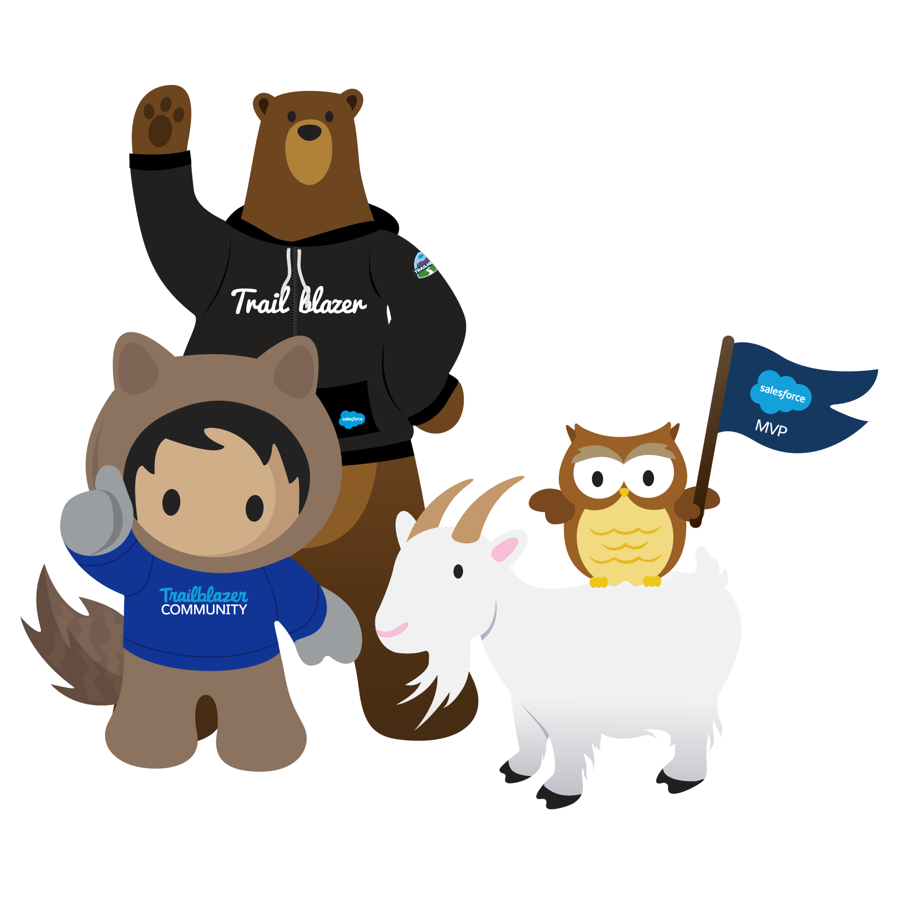
Thank You For Coming!
Now: Shaughnessy’s Pub
Next: Thurs, May 30, 4:00-5:30p, Tech Garden
Topic: Summer 19 Release Highlights
Registration opens Monday
Suggestions/Speakers welcome for June and beyond

