Slide 1

          Syracuse
          Trailblazers
          June 26
          2019

Slide 2

Connecting
Trailblazer Community Groups: Syracuse, NY Developers Group
  How we track membership, schedule meetings and RSVP to upcoming events
Twitter: @SyracuseDevs
  Posting formal meetups, informal gatherings, retweeting regional events and member activities
Chatter: Syracuse, NY Developers Group
  Conversations and discussions with other group members
Web: SyracuseDevelopers.com
  Links to the above sites, copies of slides/code presented at meetups

Slide 3
News
Salesforce Buys Tableau
  Data visualization software to generate graphs, maps and trend lines from large data sets
  $15.3 Billion deal - biggest ever for SF
  Tableau headquarters to remain in Seattle
1000 Trailblazer Community Groups
  Look for people sharing stories on twitter, blogs, linkedin, chatter, etc
  #TrailblazerCommunity
  #ThanksTrailblazers

Slide 4
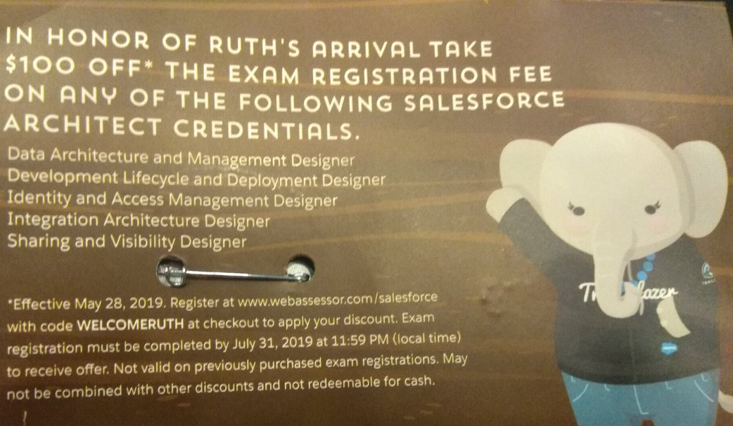
News - Ruth - The Architect
Code:
  WELCOMERUTH
Register by:
  July 31, 2019
Can probably take exam in August
Normally $400 for architect exams

Slide 5
Events
True North Dreamin’ - July 11-12
  Ottawa, Canada (3 hour drive)
  Admission: $113
  200 attendees expected
  www.truenorthdreamin.com
TrailheaDX Global Gathering - July 17
  Syracuse, NY
  Only TDX event in Upstate NY
  Special swag for attendees
Northeast Dreamin’ - Sep 16-17
  Manchester, NH (5.5 hour drive)
  Admission: $99
  500 attendees expected
  northeastdreamin.com
Dreamforce - Nov 19-22
  San Francisco (42 hour drive)
  190,000 attendees expected

Slide 6
Events
Upstate Dreamin’ ?
August 2020
Looking for planning committee members

Slide 7
Einstein Analytics
Einstein Analytics
  Emily Morse

Slide 8


Thank You For Coming!
Next: Wed, July 17, 4:00-5:30p, Tech Garden
      Topic: TDX Global Gathering
      Someone will win a Salesforce Certification voucher
      Registration open today
Future: 8/21, 9/25

