Slide 1
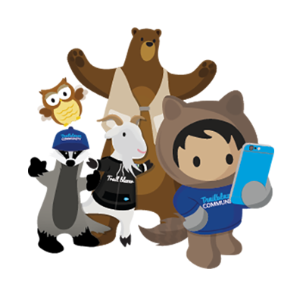
Syracuse
Trailblazers
July 17
2019

Slide 2
Connecting
Trailblazer Community Groups: Syracuse, NY Developers Group
How we track membership, schedule meetings and RSVP to upcoming events
Twitter: @SyracuseDevs
Posting formal meetups, informal gatherings, retweeting regional events and member activities
Chatter: Syracuse, NY Developers Group
Conversations and discussions with other group members
Web: SyracuseDevelopers.com
Links to the above sites, copies of slides/code presented at meetups

Slide 3
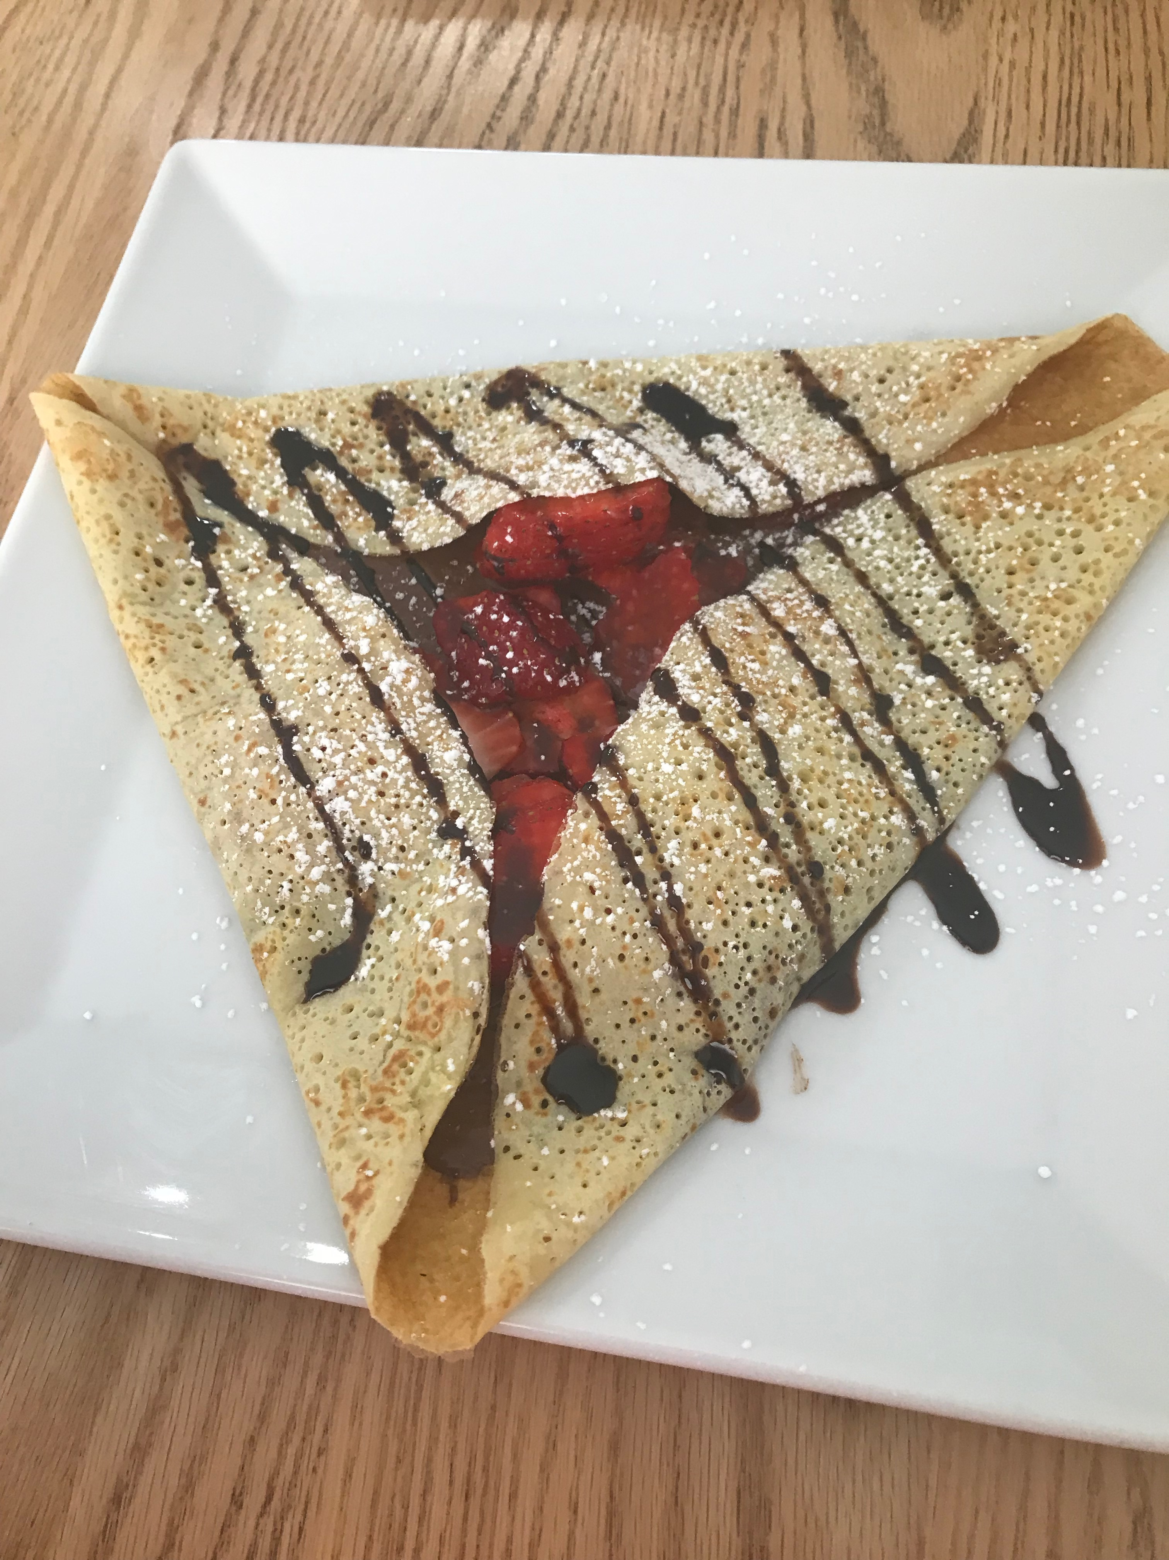
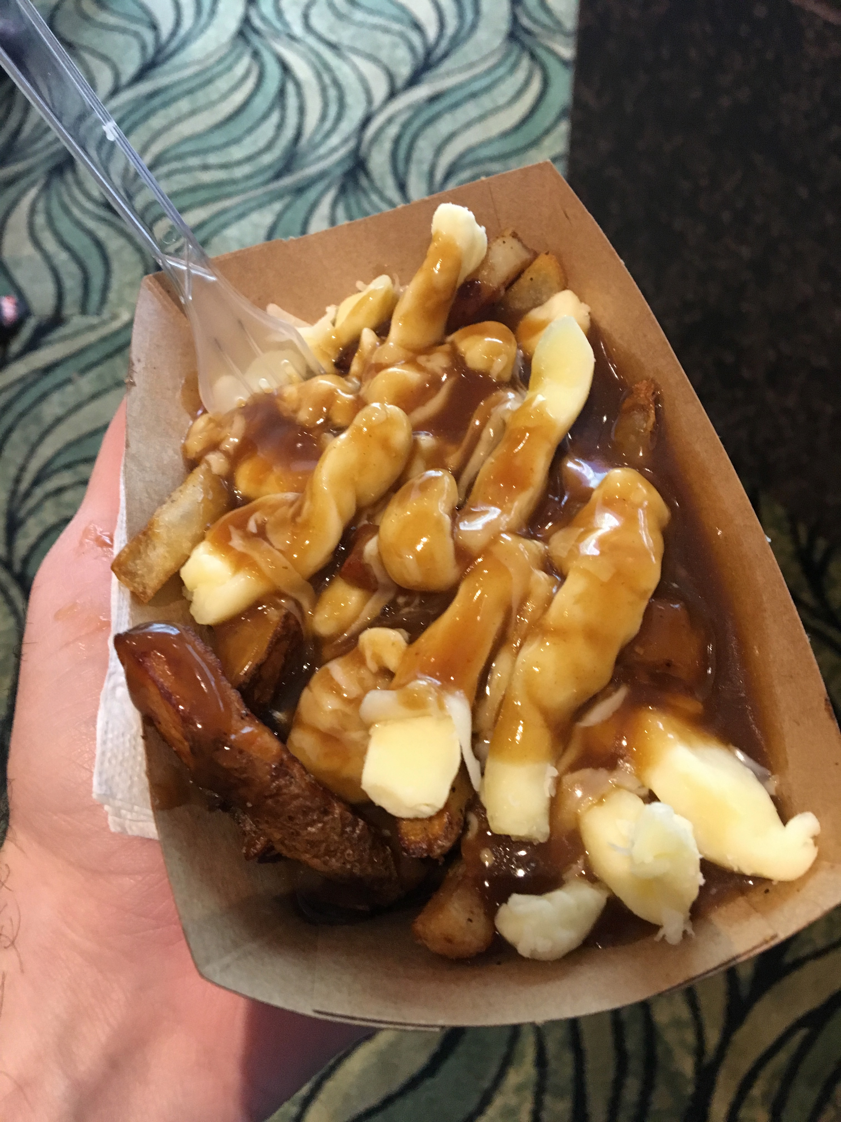
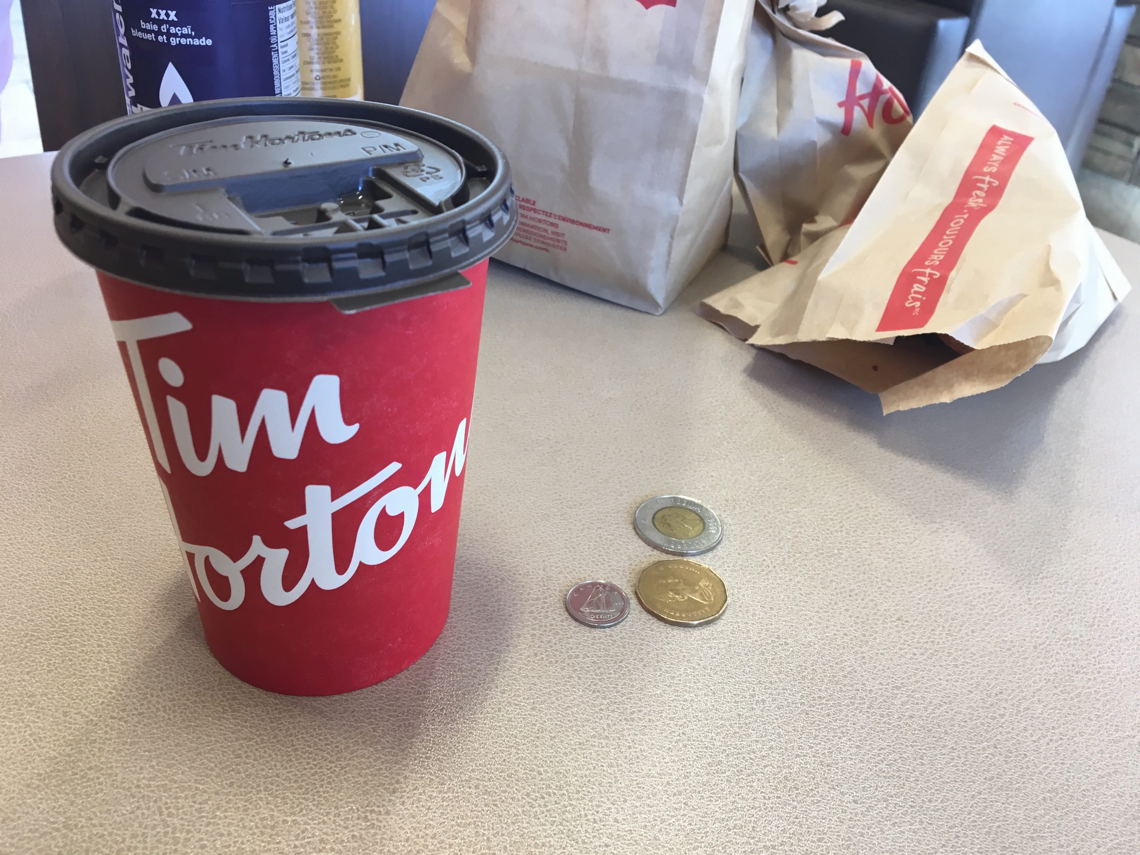
Events - True North Dreamin

Slide 4
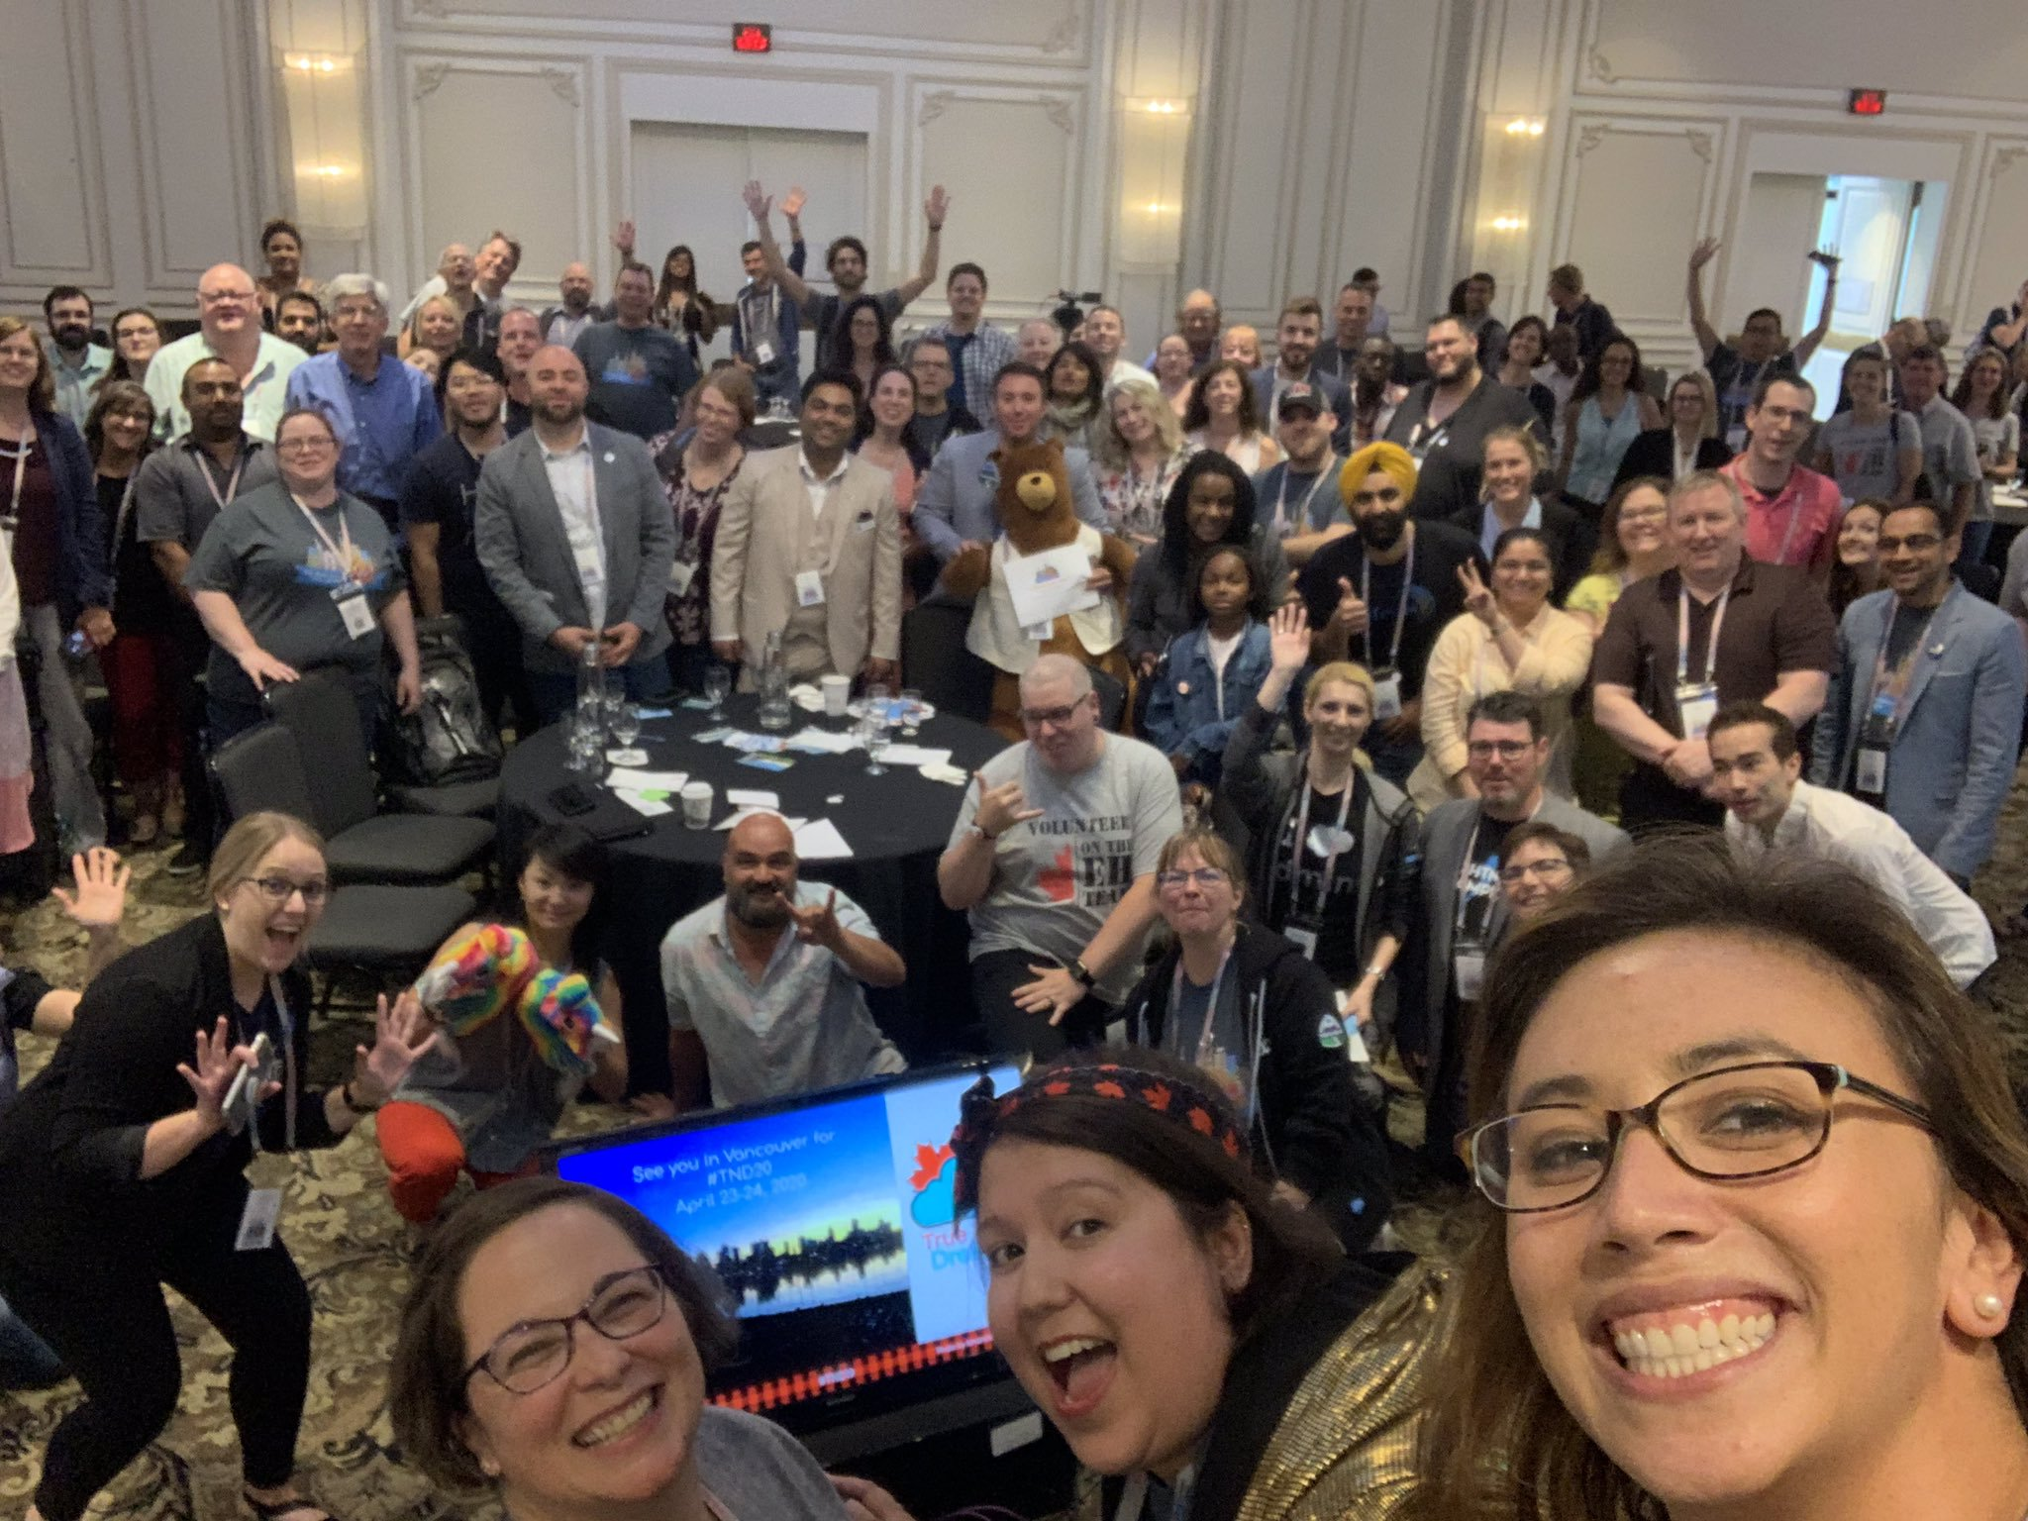
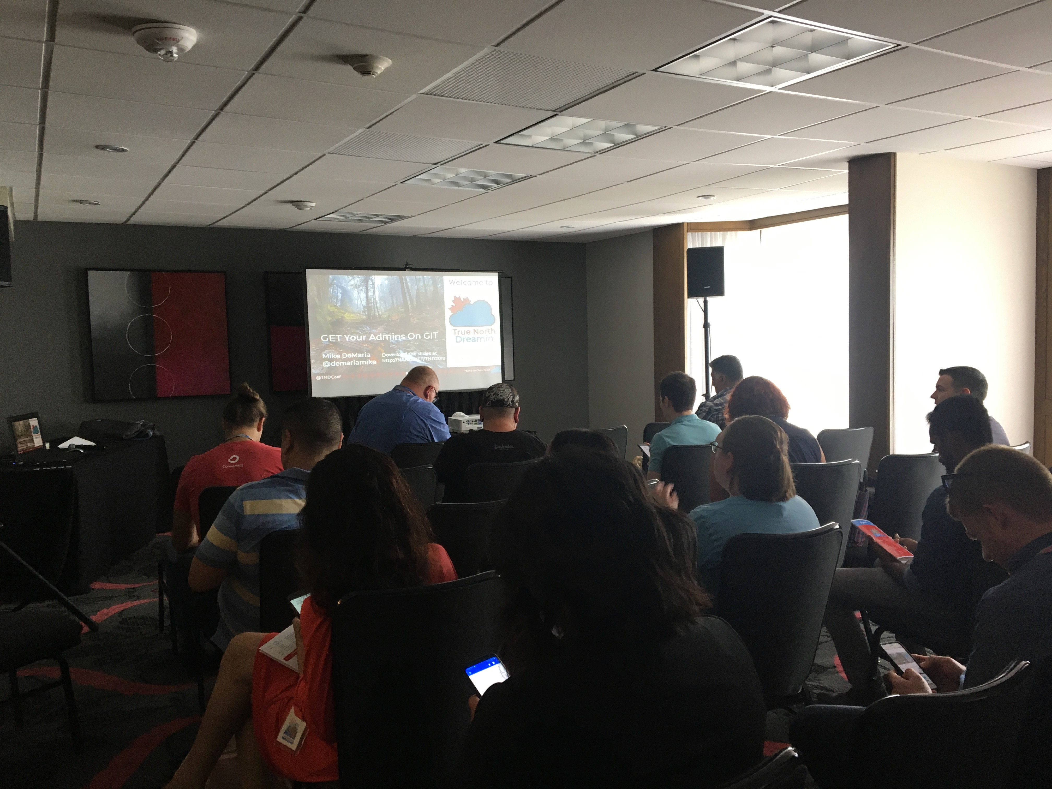
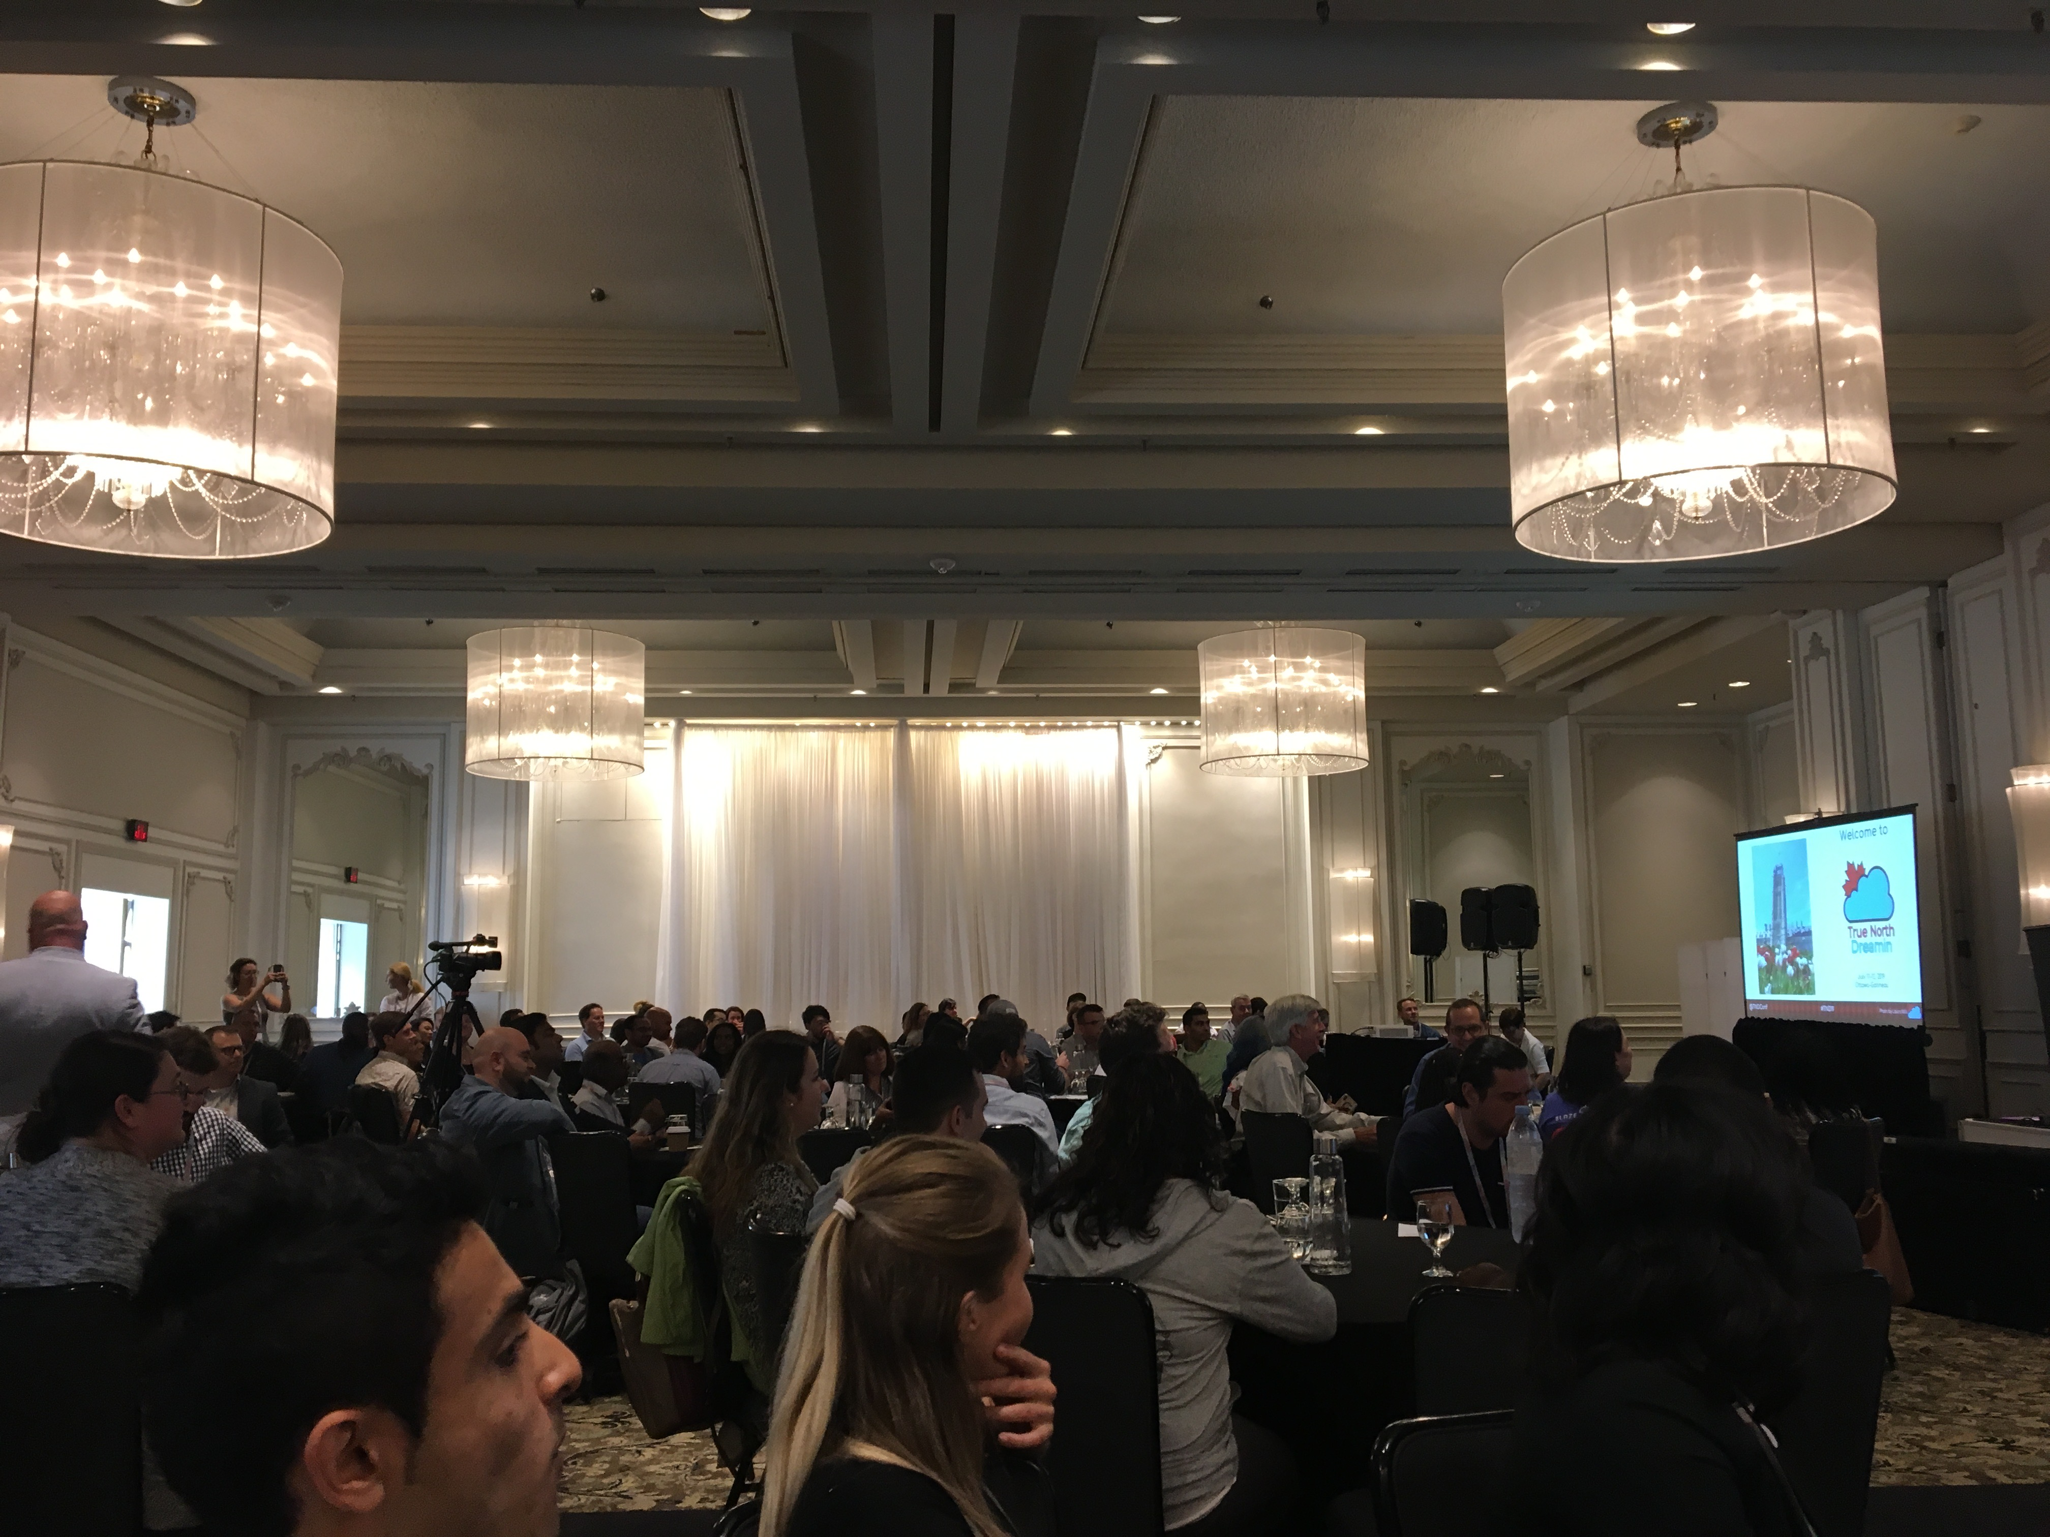
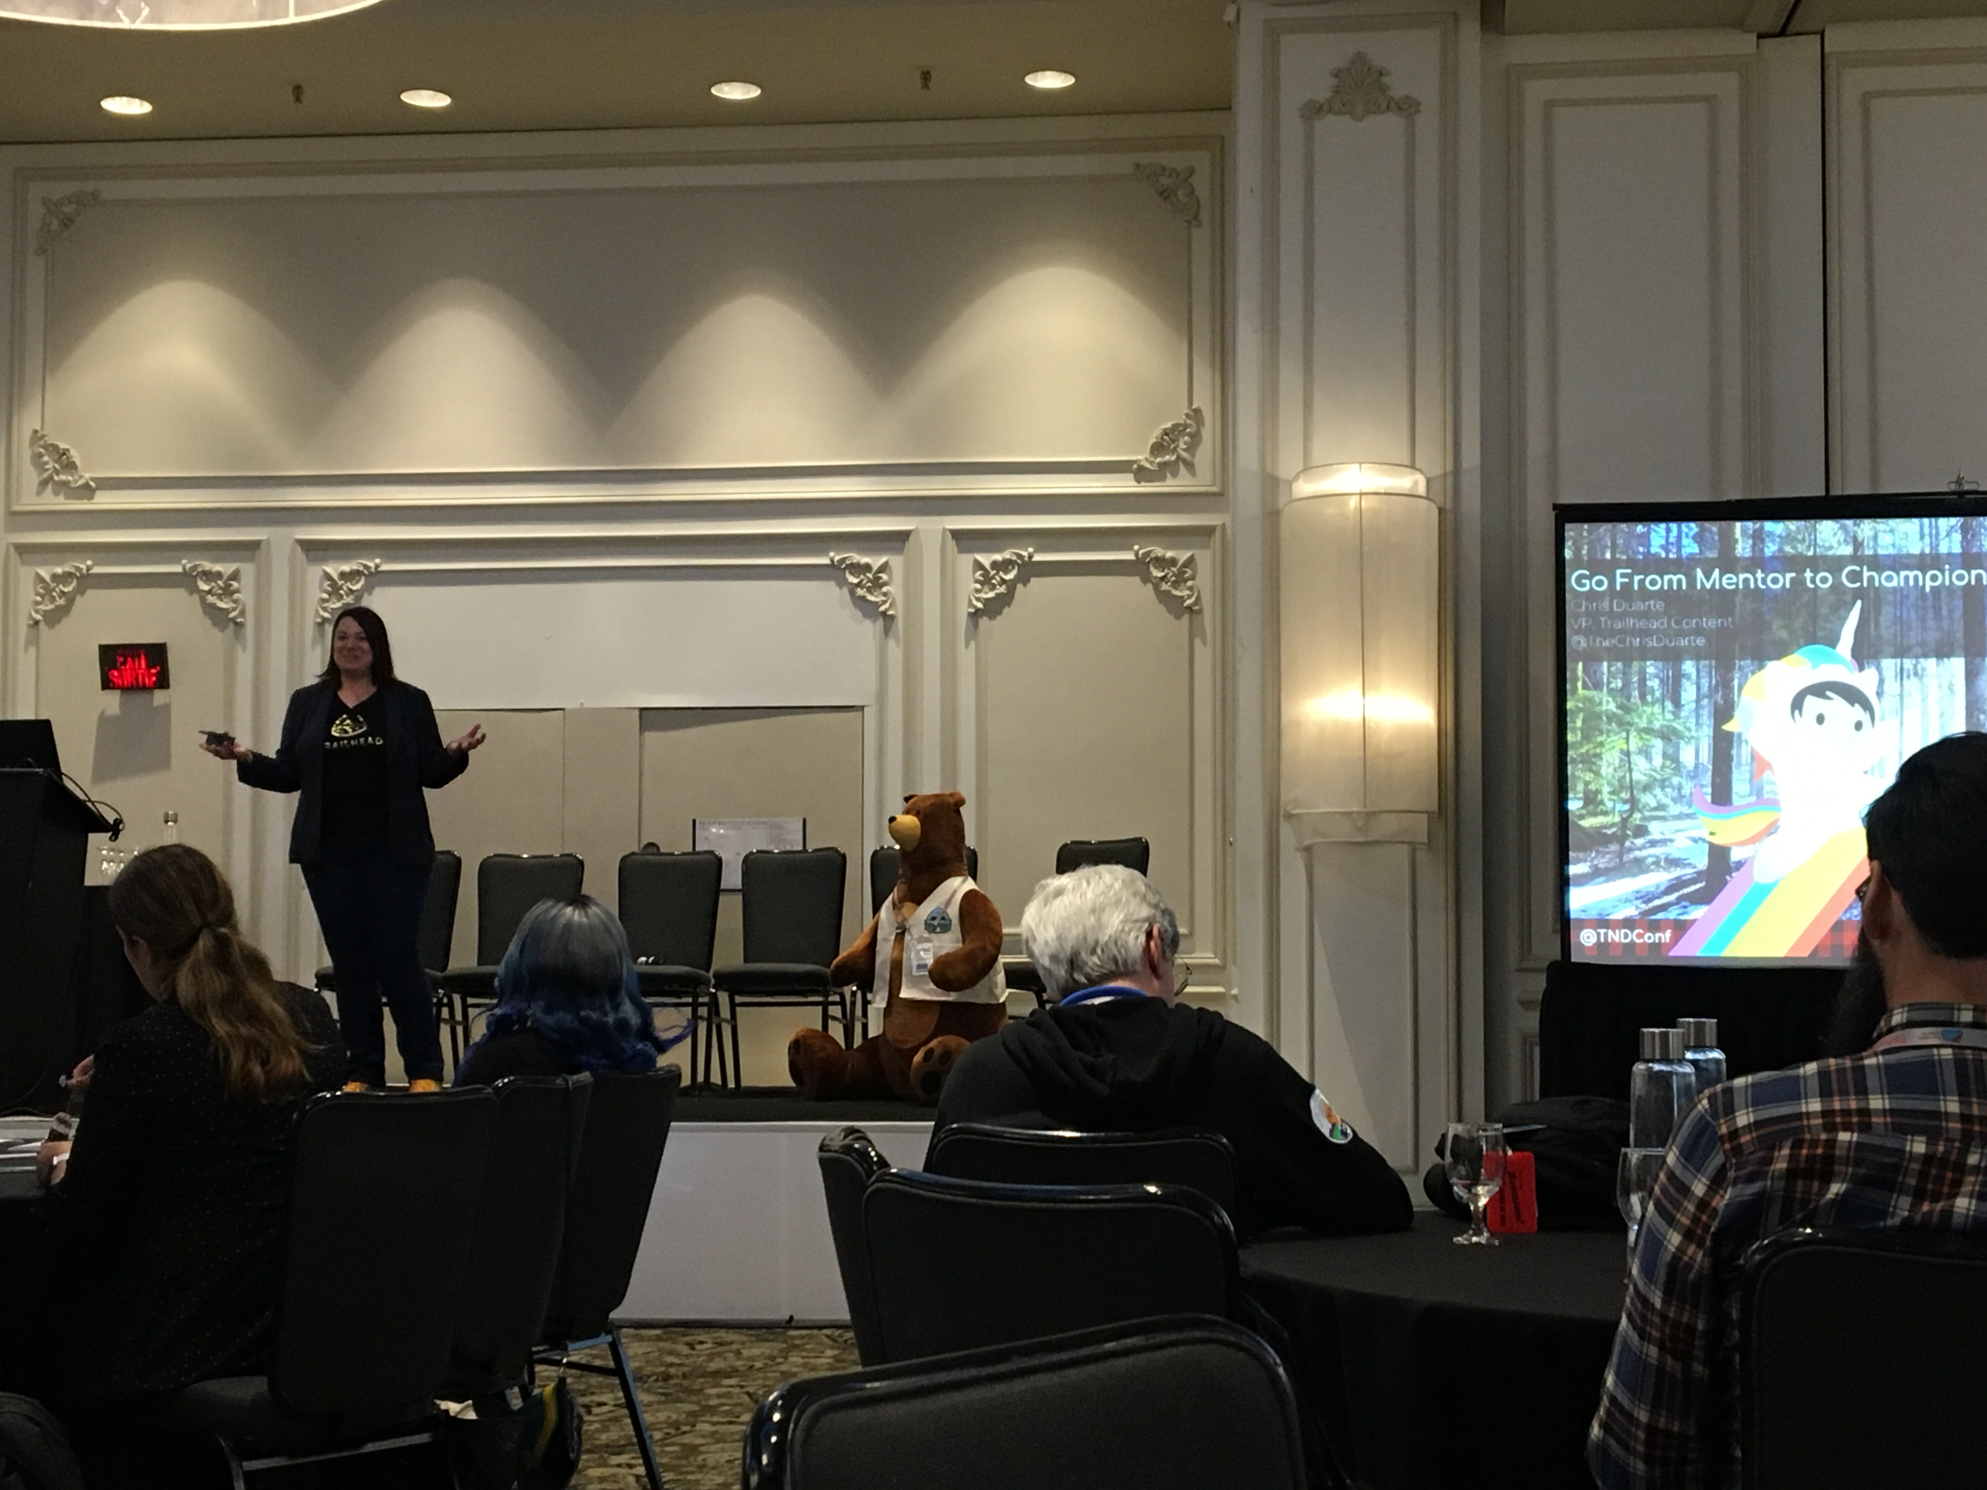
Events - True North Dreamin

Slide 5
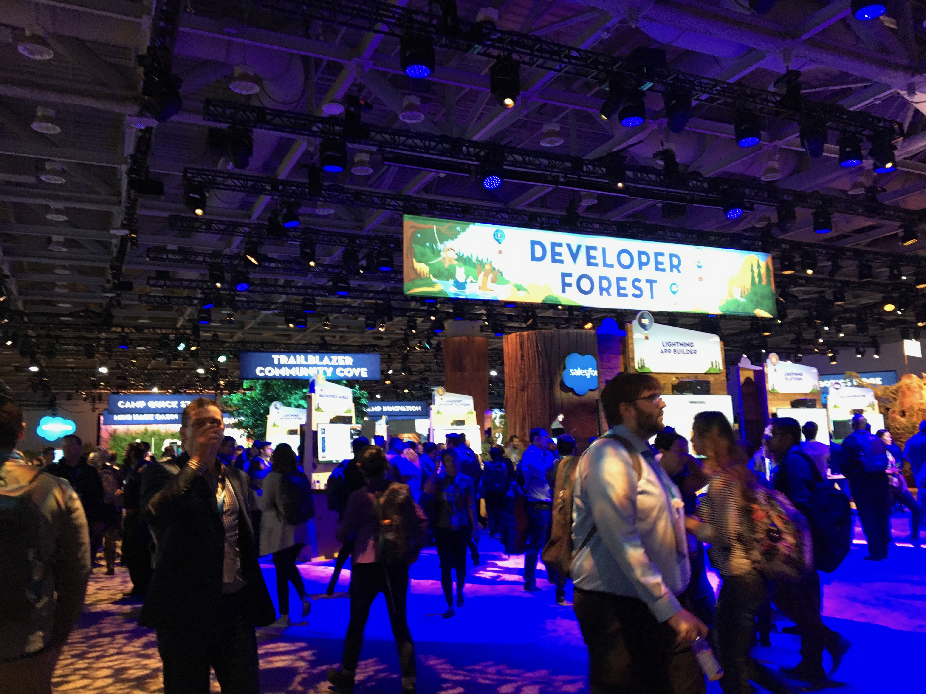
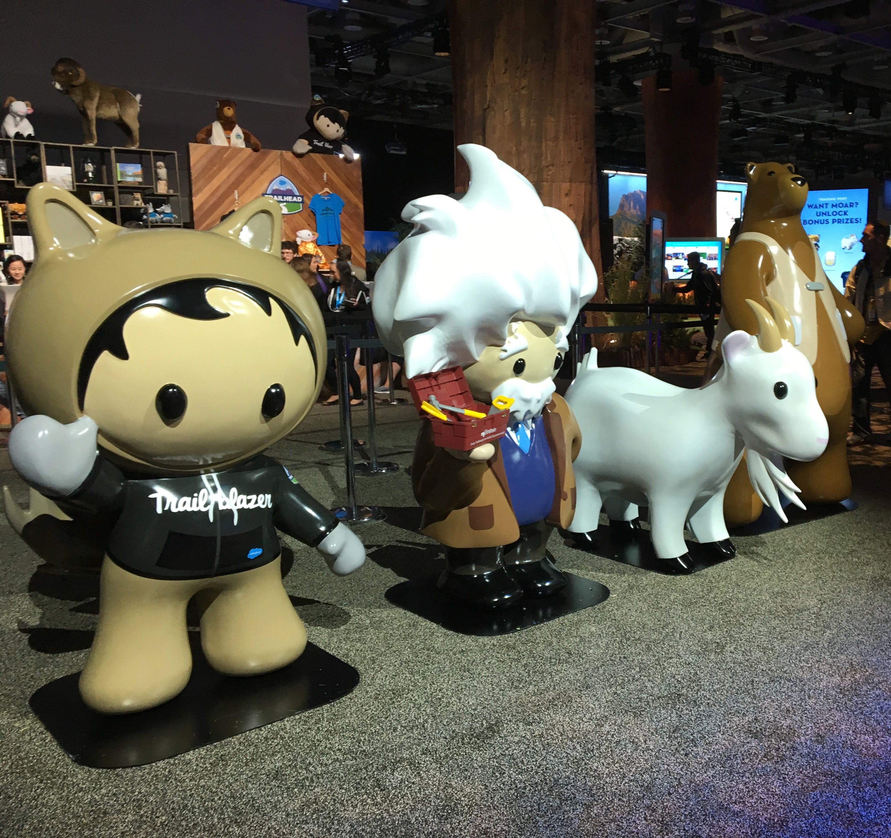
Events
Northeast Dreamin’ - Sep 16-17
Manchester, NH (5.5 hour drive)
Admission: $99
500 attendees expected
northeastdreamin.com
Dreamforce - Nov 19-22
San Francisco (42 hour drive)
190,000 attendees expected
Call for Presentations has opened
Limit of 5 submissions per person
CFP closes on 8/16

Slide 6
Events
Upstate Dreamin’
August 2020

Slide 7
Summer ‘19 Release Highlights
Salesforce Celebrations
Notification Builder
Row-Level Formulas
Enhanced Related Lists
In-App Guidance
More details on the highlights covered in this deck can be found in the trailmix: bit.ly/buildspirationadmintrailmix

Slide 8
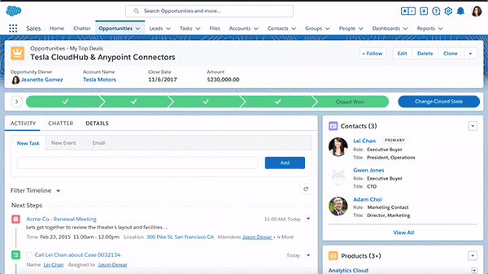
Salesforce Celebrations
Celebration is a fun, visual way to engage your users and celebrate wins with them right on their Salesforce screen.
In Setup, find the Path Setting (and enable).
Then, configure your path to add celebrations in step three of your Path configuration wizard.

Slide 9
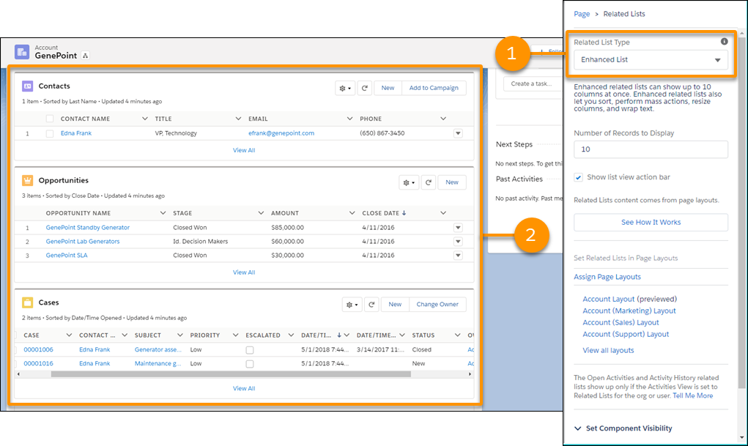
Enhanced Related Lists (Beta)
With Enhanced Related Lists, you can:
Show all 10 columns & up to 30 rows
Smart column widths
End user sorting
Text wrapping
Resizable columns
Mass actions
#1 from Dreamforce
True To The Core
IDX points: 35,020

Slide 10
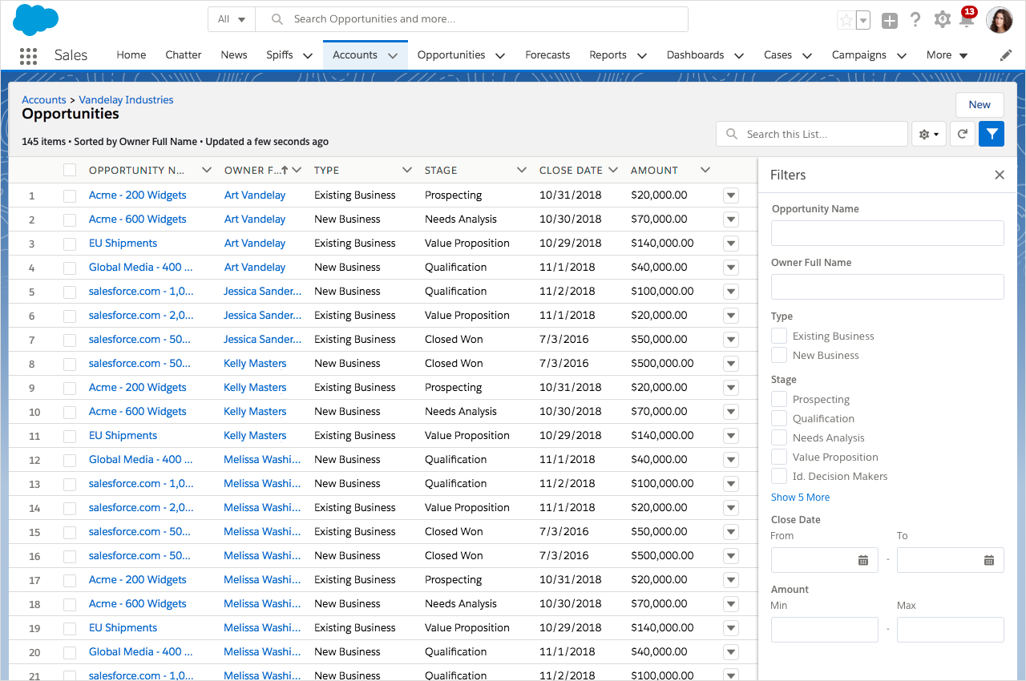
More Related List Enhancements with Filters
Quickly Filter Related List Data
End users can now quickly filter related lists to find just what they need. Filter on:
Text
Dates
Currency
Percent
Picklists
Lookups
Boolean
Many more
#2 from Dreamforce
True To The Core
IDX points: 19,530

Slide 11
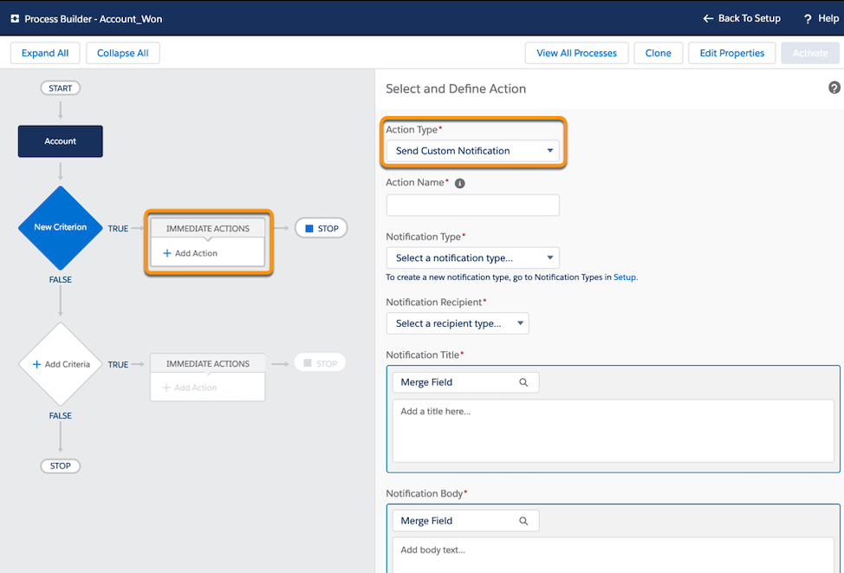
Notification Builder
Notification Builder puts you in control of who needs to know what and when.
Send customized in-app notifications when important events occur with Process Builder.

Slide 12
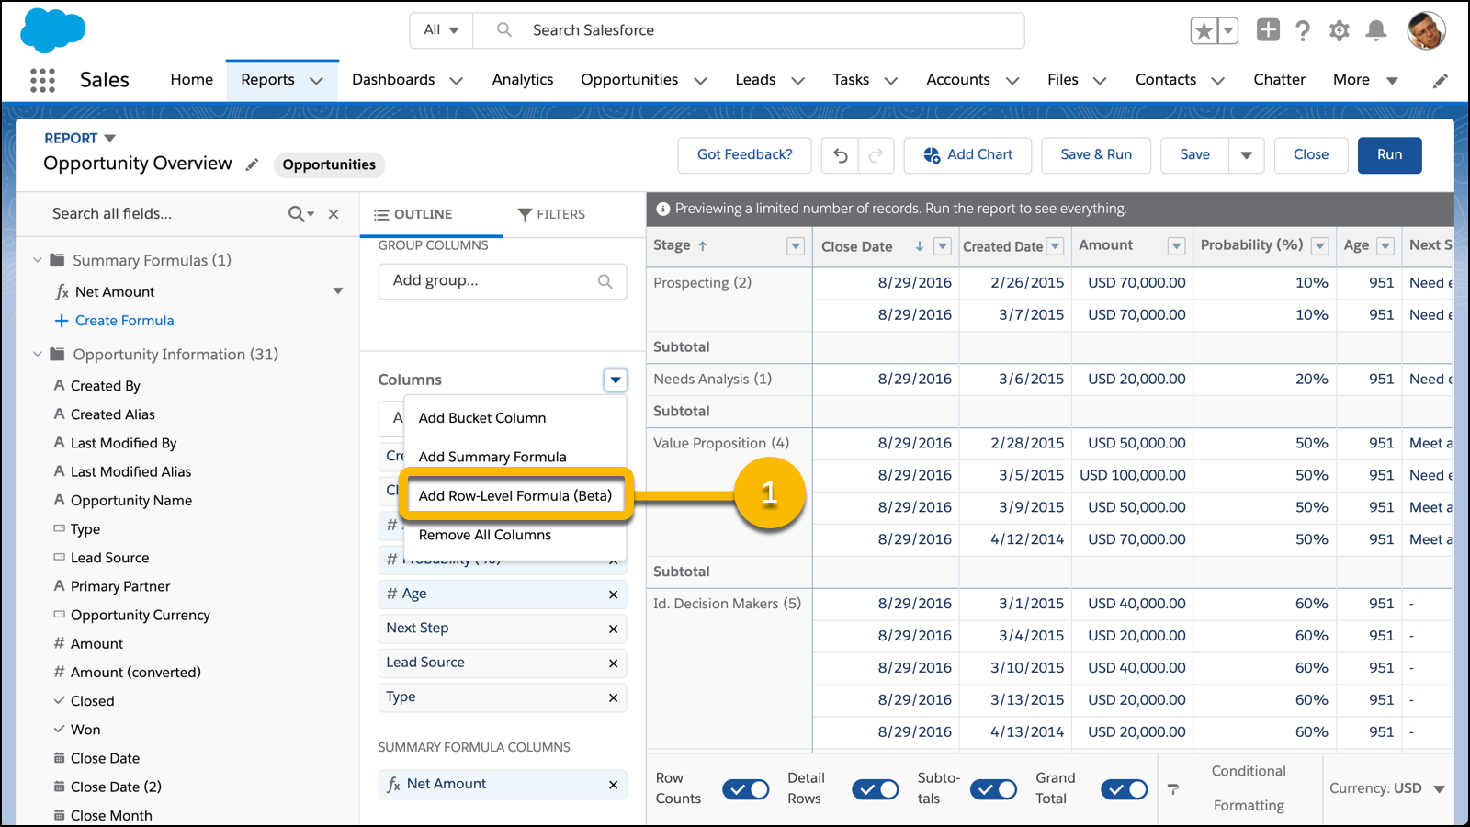
Row-Level Formulas
With row-level formulas, you don't need to export report data to a spreadsheet or ask an admin to create a one-off custom formula field to get important calculations for your business.
Add formulas in Report Builder.

Slide 13
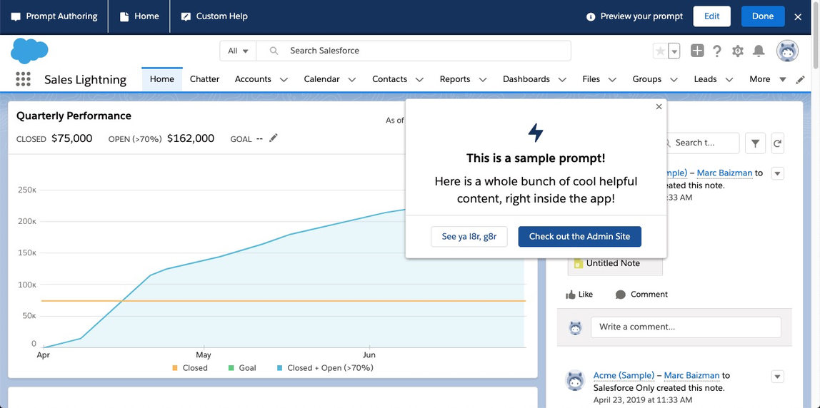
In-App Guidance
Create pop-up windows to help onboard and train your users.
Include links to other resources.
Customize:
Page(s) for prompt to show up on
How often users see the prompts
Additional resource links to include
Activate this feature in:
Setup | User Engagement | In-app Guidance

Slide 14
Check out Syr Devs May 30th meeting slides for more info about Summer 19!

Slide 15
Learn about Salesforce Blockchain
​sforce.co/blockchain

Slide 17
Make Trailhead your next step
BE AN EMPOWERED TRAILBLAZER
sforce.co/summer19
Get ready for the Summer ‘19 release
sforce.co/build
Explore Lightning Web Components
and contribute now
sforce.co/blockchain
Start building blockchain apps today
sforce.co/integrate
Learn how to integrate any app,
data, and device
sforce.co/TDX19keynote
Take the TrailheaDX ‘19 Highlights Trailmix

Slide 19
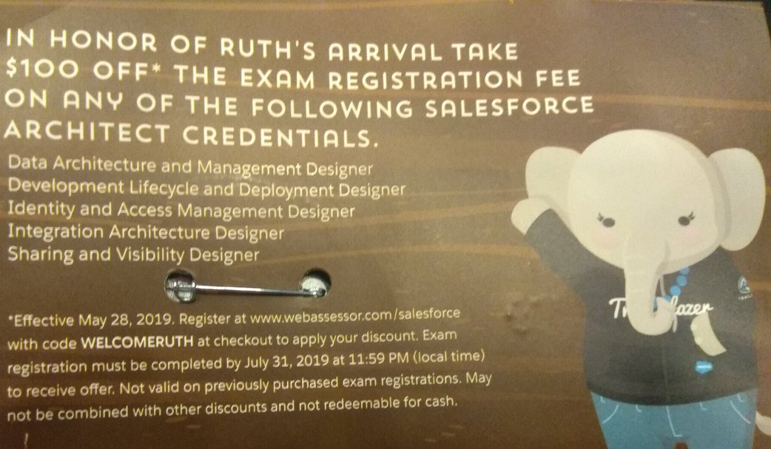
Certification Exams
Code:
WELCOMERUTH
Register by:
July 31, 2019
Can probably take exam in August
Normally $400 for architect exams

Slide 20
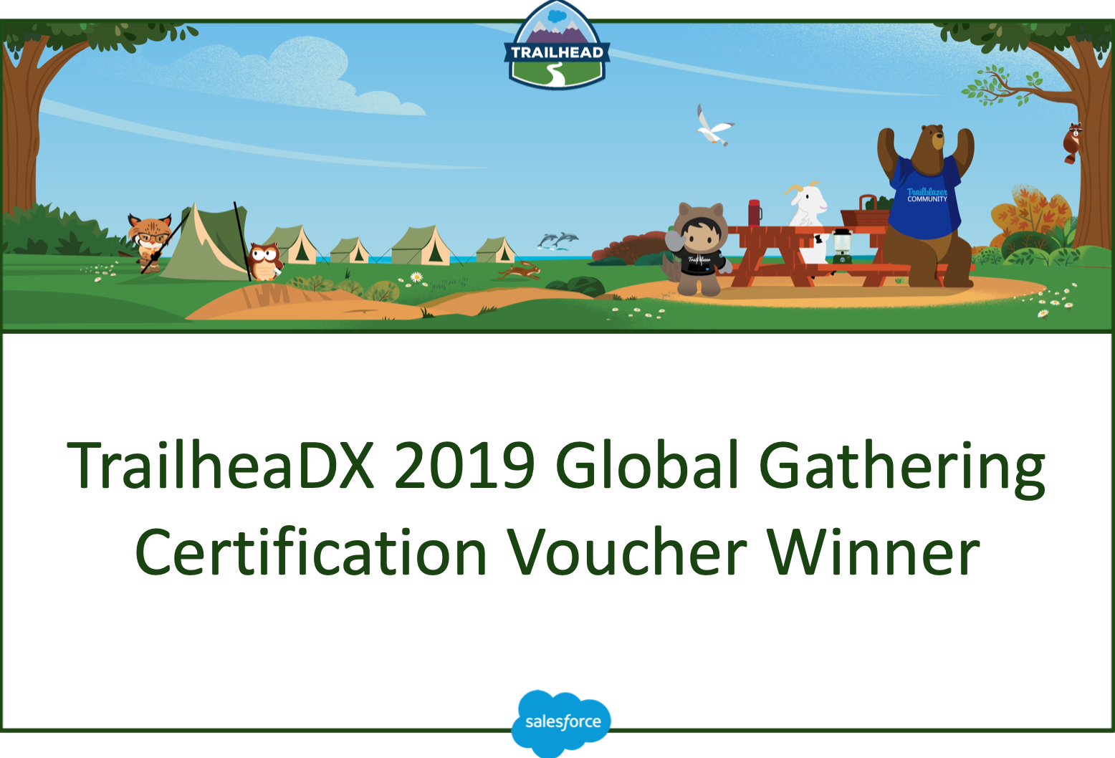
Certification Exams
http://SyracuseDevelopers.com/exam

Slide 21
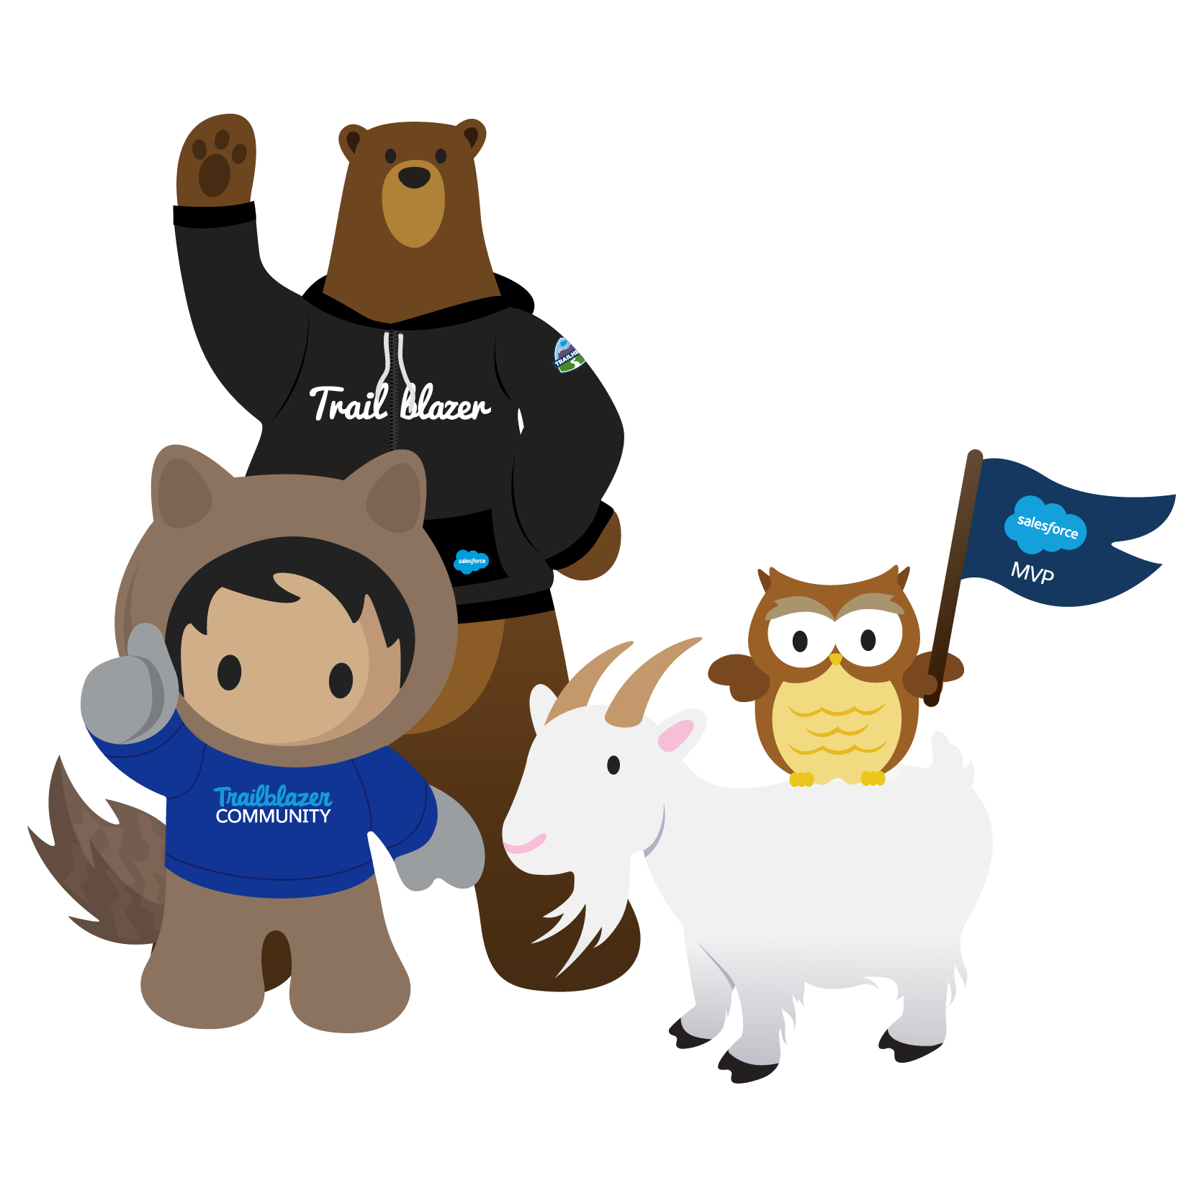
Thank You For Coming!
Next: Wed, Aug 21, 4:00-5:30p, Tech Garden
Topic: Source control basics or SFDX for Admins
Registration opens tomorrow
Future: 9/25

