Slide 1
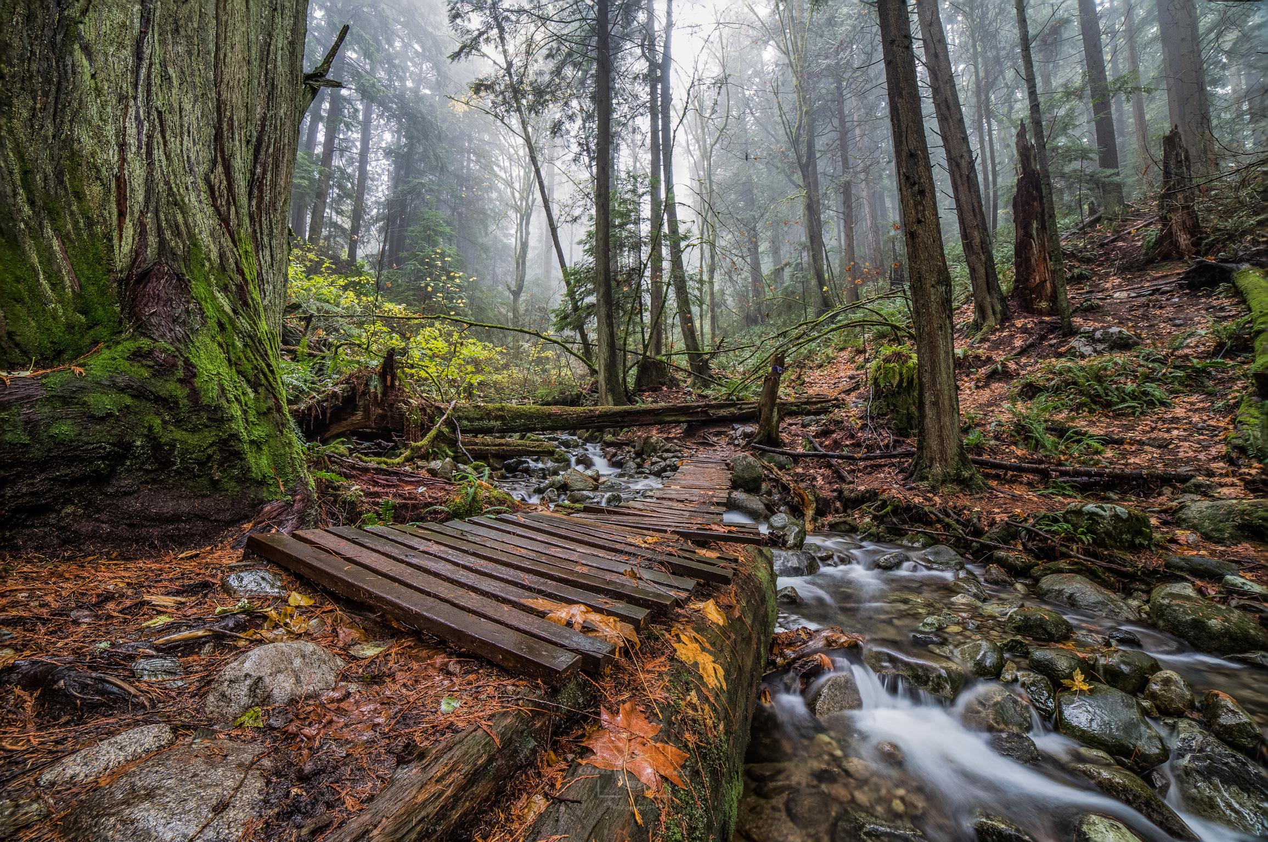
GET Your Admins On GIT
Mike DeMaria
@demariamike
Download the slides at
http://NAND.NET/TND2019
Photo by Chris Seed

Slide 3
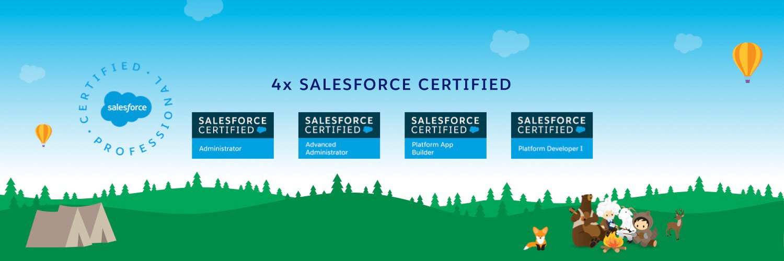
Bio
Syracuse, New York Developers Community Group
IT Professional since 2001
Salesforce since January 2015
Developer, QA, Sys Admin, Technology Writer/Editor

Slide 4
Why GIT?
Why we use source control

Slide 5
Why GIT?
What is source control or version control software?
    “The Source Code Control System (SCCS) is a software tool designed to help programming projects control changes to source code. It provides facilities for sorting, updating, and retrieving all versions of modules, for controlling updating privileges, for identifying load modules by version number, and for recording who made each software change, when and where it was made, and why.”
      -- Marc J. Rochkind

Slide 6
Why GIT?
What is source control or version control software?
    “The Source Code Control System (SCCS) is a software tool designed to help programming projects control changes to source code. It provides facilities for sorting, updating, and retrieving all versions of modules, for controlling updating privileges, for identifying load modules by version number, and for recording who made each software change, when and where it was made, and why.”
      -- Marc J. Rochkind, 1975
    https://basepath.com/aup/talks/SCCS-Slideshow.pdf

Slide 7
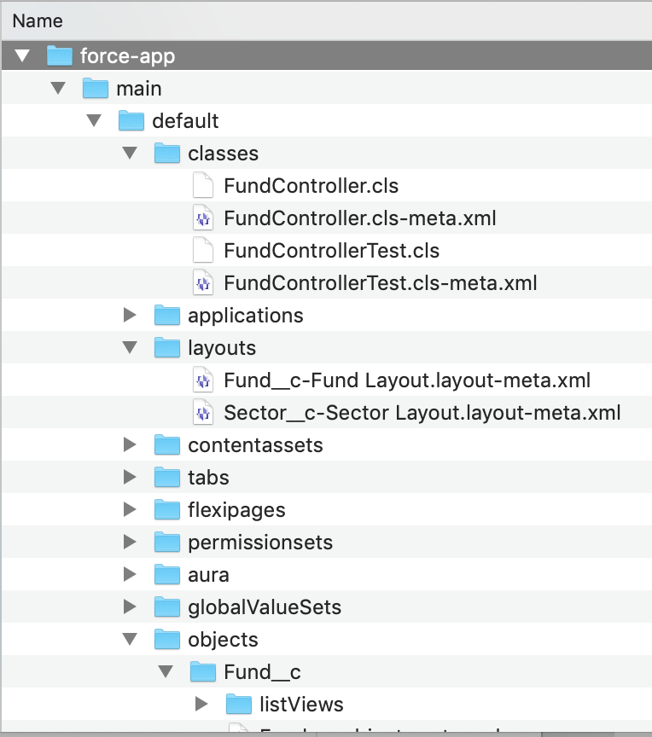
Why GIT?
What are common features?
Full backup of project
Revision history
Audit log
Merging
Code approvals
Automated actions (CI/CD)
If it’s not in git, it doesn’t exist.

Slide 8
Why GIT?
GIT is “correct”.
Not production.
Not the sandbox.
Not the backup sandbox.
Not the word document on Kris’ laptop.
It becomes the source of truth, the gold standard.
What’s in git is how the system is supposed to be.
What are common features?
Full backup of project
Revision history
Audit log
Merging
Code approvals
Automated actions (CI/CD)

Slide 9
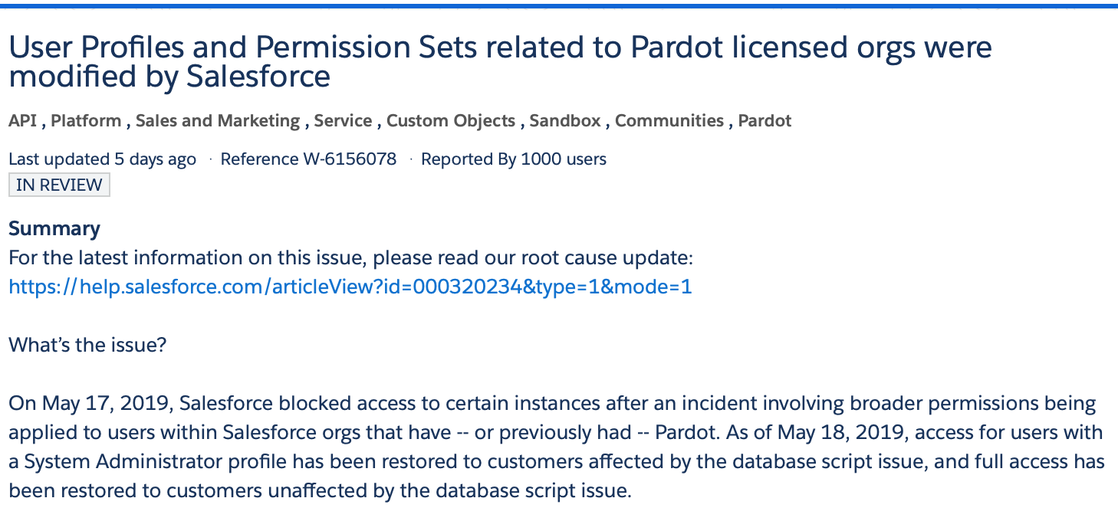
Why GIT?

Slide 10
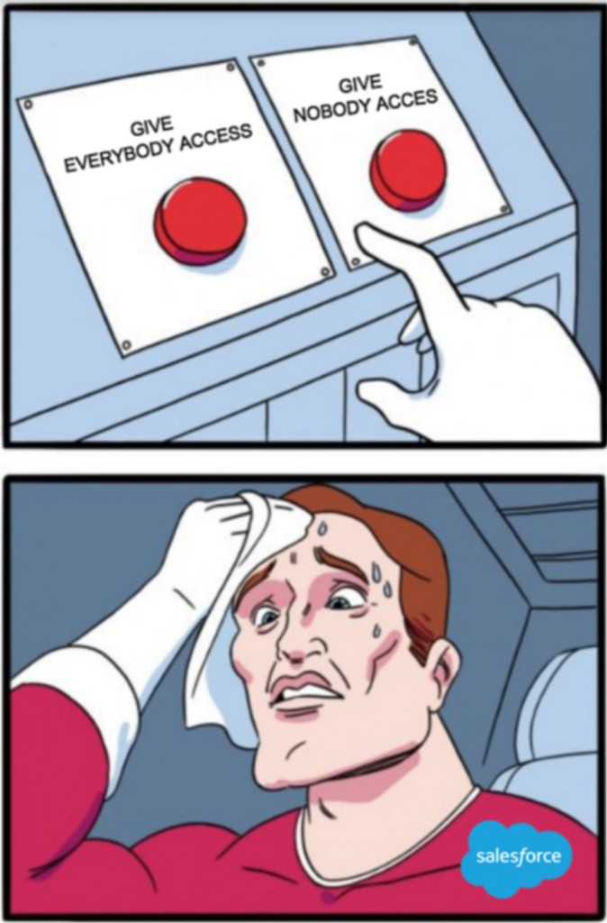
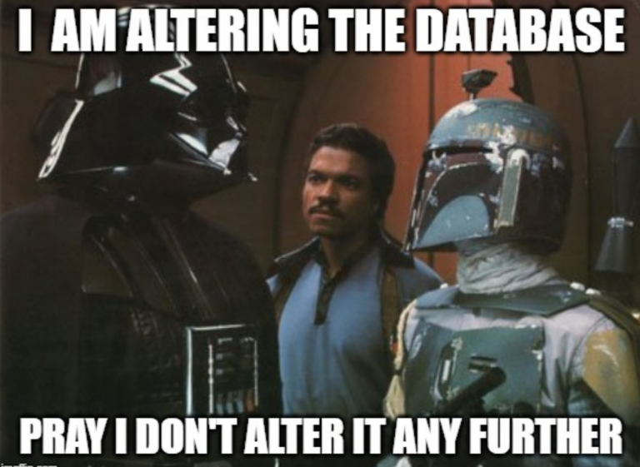
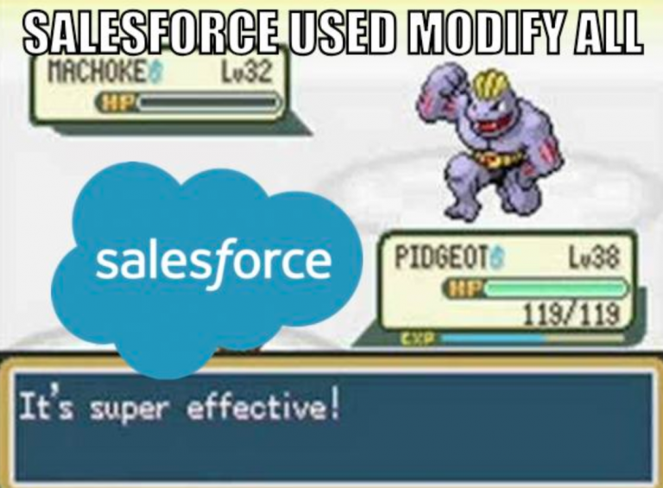
Why GIT?

Slide 11
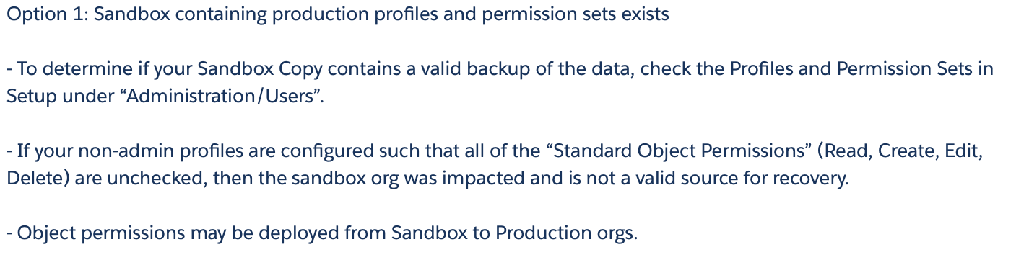
Why GIT?

Slide 12
Why GIT?

Slide 13
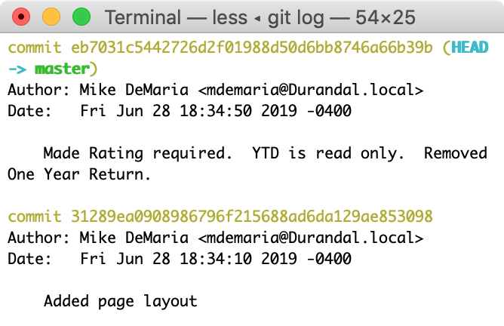
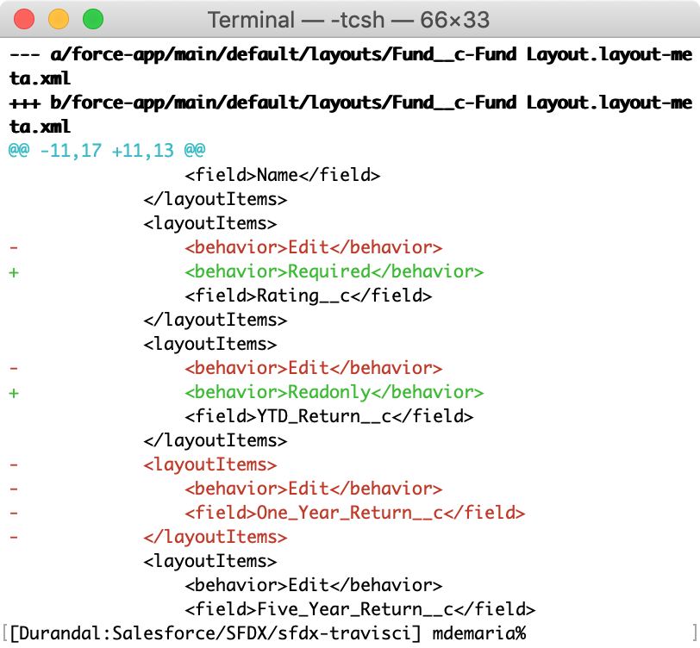
Why GIT?
What are common features?
Full backup of project
Revision history
Audit log
Merging
Code approvals
Automated actions (CI/CD)

Slide 14
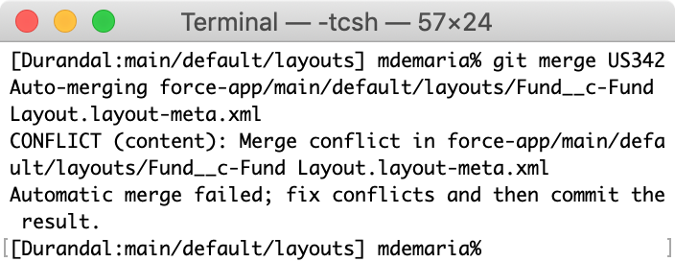
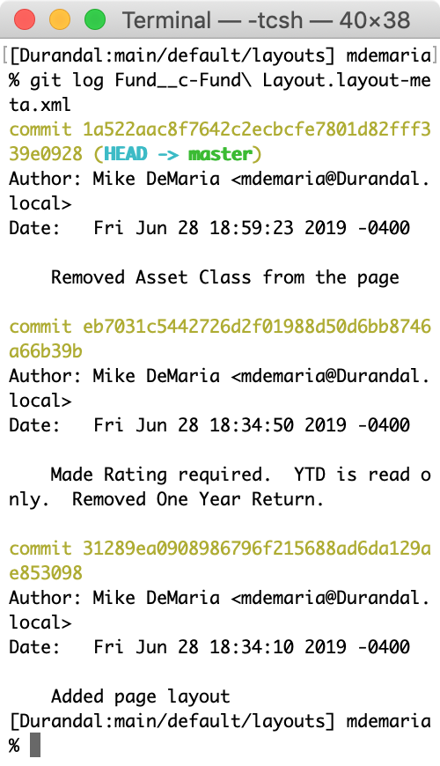
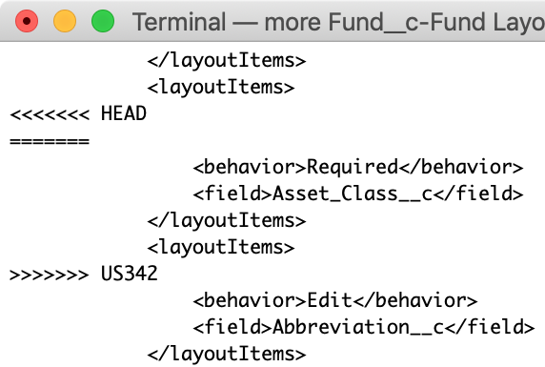
Why GIT?
What are common features?
Full backup of project
Revision history
Audit log
Merging
Code approvals
Automated actions (CI/CD)
Admin 1 – Set Asset Class to required on page layout
Admin 2– Removed Asset Class from page layout

Slide 15
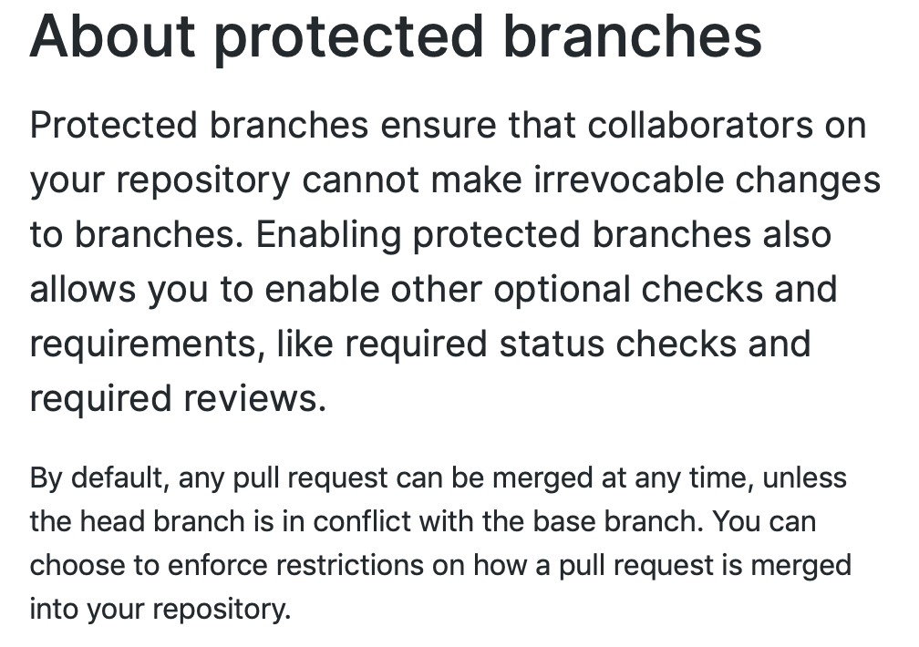
Why GIT?
What are common features?
Full backup of project
Revision history
Audit log
Merging
Code approvals
Automated actions (CI/CD)

Slide 16
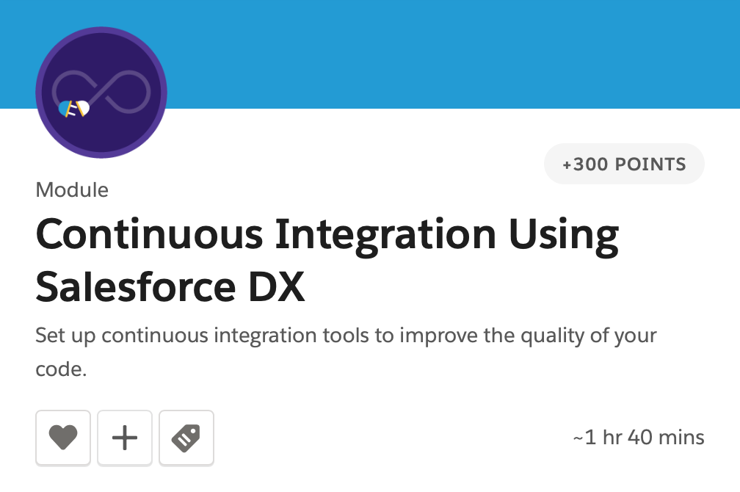
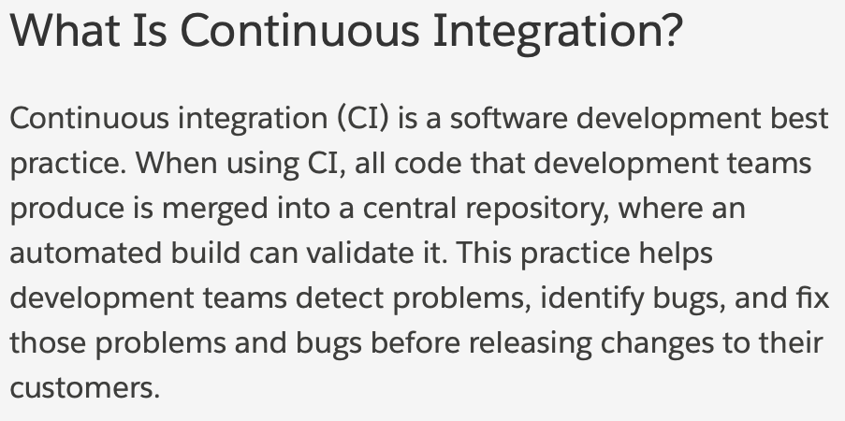
Why GIT?
What are common features?
Full backup of project
Revision history
Audit log
Merging
Code approvals
Automated actions (CI/CD)

Slide 17
Why Admins?
Expand the definition of developer

Slide 18
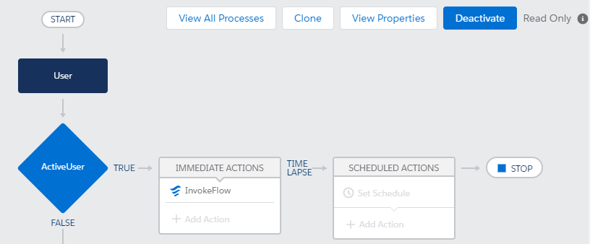
Why Admins?

Slide 19
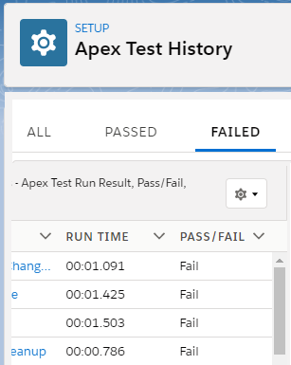
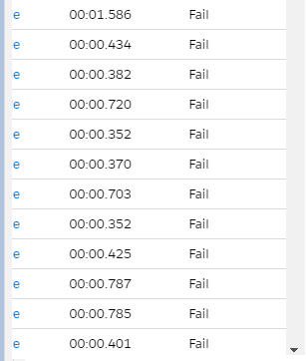
Why Admins?

Slide 20
Why Admins?
Do admins make changes that affect code?
Yes
Do developers need to be aware of admin activities?
Yes
Do admin activities need to be deployed via CI/CD?
Yes
Do admins write code?

Slide 21
Why Admins?
IF( ISPICKVAL(Status,'New')&&SLAHoursMonitor__c>1.75,
IMAGE("/sfc/servlet.shepherd/version/renditionDownload?rendition=ORIGINAL_Gif&versionId=0681E000002lur3&operationContext=CHATTER&contentId=05T1E00000AIPYE", "SLA ALERT!", 15, 15),"")
IF(CONTAINS(Days__c,Text(weekday(Current_Local_Date__c))),IF(From__c < To__c,IF((( Current_Local_Time__c >= From__c ) && (Current_Local_Time__c <= To__c )),true, false),IF(((Current_Local_Time__c+43200000 >= From__c+43200000 ) && ((Current_Local_Time__c+43200000) <= (To__c+43200000))),true,false )),false)
*Thank you Daniel Barckley and Marc Behr

Slide 22
Why Admins?
TEXT(YEAR(ActivityDate + DurationInMinutes/1440 + Created_By_TimeZone_Offset__c/24)) & "-" &
LPAD(TEXT(MONTH(ActivityDate + MFLOOR((DurationInMinutes/1440) + Created_By_TimeZone_Offset__c/24))), 2, "0") & "-" &
LPAD(TEXT(DAY(ActivityDate + DurationInMinutes/1440 - IF(DurationInMinutes/1440 >= 1,1,0) + Created_By_TimeZone_Offset__c/24)), 2, "0") &
IF(
IsAllDayEvent = FALSE,
" " & TEXT(MFLOOR(HOUR(TIMEVALUE(ActivityDateTime)) + DurationInMinutes/60 + Created_By_TimeZone_Offset__c)- (MFLOOR(DurationInMinutes/1440) * 24)+IF(MFLOOR(MINUTE(TIMEVALUE(ActivityDateTime)) + ((DurationInMinutes/60 - MFLOOR(DurationInMinutes/60))*60)) > 59,1,0)) & ":" &
IF(LEN(TEXT(MINUTE(TIMEVALUE(ActivityDateTime)) + ((DurationInMinutes/60 - MFLOOR(DurationInMinutes/60))*60))) = 1, "0", "") &
TEXT(MFLOOR(MINUTE(TIMEVALUE(ActivityDateTime)) + ((DurationInMinutes/60 - MFLOOR(DurationInMinutes/60))*60))- IF(MFLOOR(MINUTE(TIMEVALUE(ActivityDateTime)) + ((DurationInMinutes/60 - MFLOOR(DurationInMinutes/60))*60)) > 59,60,0)),
""
)
*Thank you Stéphane Houle

Slide 23
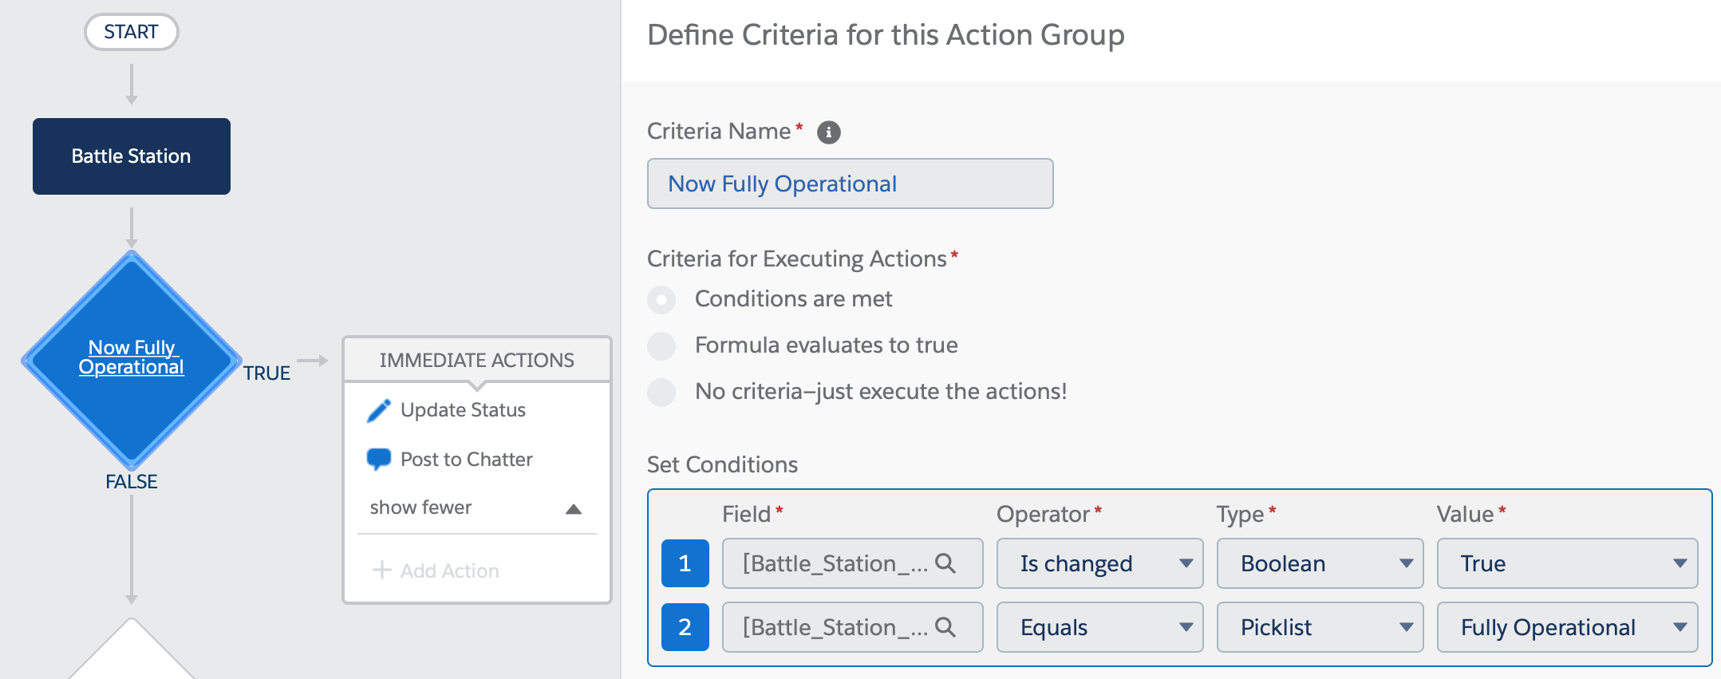
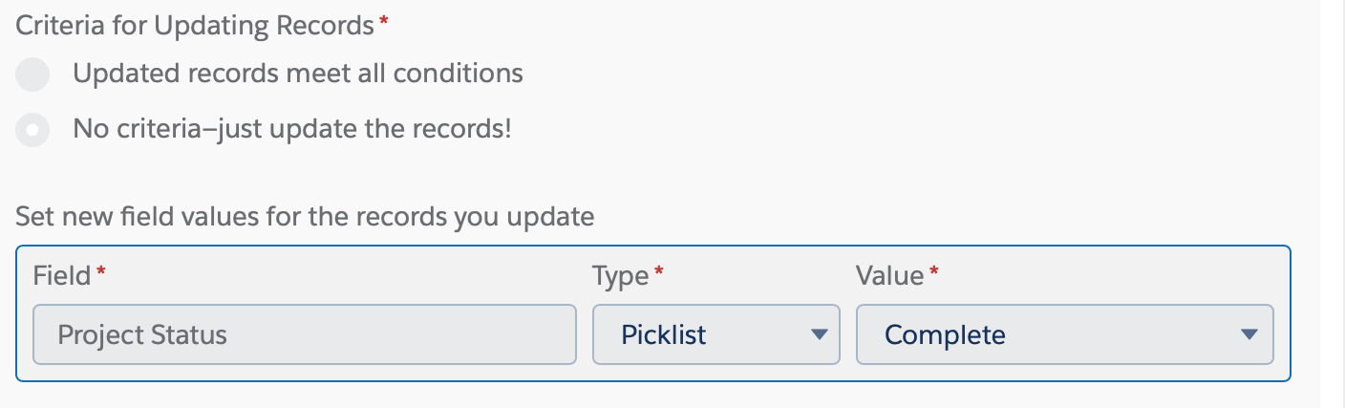
Why Admins?

Slide 24
Why Admins?
In Salesforce, you don’t need to write Apex to write code.
We are all builders, crafters, developers and programmers.

Slide 25
Why Admins?
In Salesforce, you don’t need to write Apex to write code.
We are all builders, crafters, developers and programmers.
Admins
Developers
Adminveloper
Software development team

Slide 26
Why Admins?
In Salesforce, you don’t need to write Apex to write code.
We are all builders, crafters, developers and programmers.
Admins
Developers
Software development team

Slide 27
Why Admins?
You are a member of the software development team.
Access to the source control system is a barrier of entry.
You become increasingly reliant on others to get your work done.
It is harder to acquire new skills and/or change roles without access.

Slide 28
How?
How source control works

Slide 29
Basic Branching
Master
A
B
C
Time

Slide 30
Basic Branching
Master
A
B
C
Time
Branch
A
B
C

Slide 31
Basic Branching
Master
A
B
C
A
B
C
Time
Branch
A
B
C
A
B
X
C
Develop

Slide 32
Basic Branching
Master
A
B
C
A
B
C
A
B
X
C
Time
Branch
Merge
A
B
C
A
B
X
C
Develop

Slide 33
Multi Developer Branching
Master
A
B
C
Time

Slide 34

Multi Developer Branching
Master
A
B
C
Doug’s Branch
Time
A
B
C

Slide 35
Multi Developer Branching
Master
A
B
C
A
B
C
Doug’s Branch
Time
A
B
C
A
B(r)
X
C
Dev

Slide 36

Multi Developer Branching
A
B
C
Bob’s Branch
Master
A
B
C
A
B
C
Doug’s Branch
Time
A
B
C
A
B(r)
X
C
Dev

Slide 37
Multi Developer Branching
A
B
C
A
B
C
Bob’s Branch
Master
A
B
C
A
B
C
A
B(r)
X
C
Doug’s Branch
Merge
Time
A
B
C
A
B(r)
X
C
Dev

Slide 38
Multi Developer Branching
A
B
C
A
B
C
A
C
Dev
Bob’s Branch
Master
A
B
C
A
B
C
A
B(r)
X
C
A
B(r)
X
C
Doug’s Branch
Merge
Time
A
B
C
A
B(r)
X
C
Dev

Slide 39
Multi Developer Branching
Resolve merge conflict
A
B
C
A
B
C
A
C
A
X
C
Dev
Bob’s Branch
Merge
Master
A
B
C
A
B
C
A
B(r)
X
C
A
B(r)
X
C
A
B(r)
X
C
Doug’s Branch
Merge
Time
A
B
C
A
B(r)
X
C
Dev

Slide 40
Multi Developer Branching
Resolve merge conflict
A
B
C
A
B
C
A
C
A
X
C
A
X
C
D
Dev
Dev
Bob’s Branch
Merge
Master
A
B
C
A
B
C
A
B(r)
X
C
A
B(r)
X
C
A
B(r)
X
C
A
B(r)
X
C
Doug’s Branch
Merge
Time
A
B
C
A
B(r)
X
C
Dev

Slide 41
Multi Developer Branching
Resolve merge conflict
A
B
C
A
B
C
A
C
A
X
C
A
X
C
D
Dev
Dev
Bob’s Branch
Merge
Merge
Master
A
B
C
A
B
C
A
B(r)
X
C
A
B(r)
X
C
A
B(r)
X
C
A
B(r)
X
C
A
X
C
D
Doug’s Branch
Merge
Time
A
B
C
A
B(r)
X
C
Dev

Slide 42
Advanced Branching
Branch of a branch
Hotfix Branch
Monthly Release Branch
Time

Slide 43
Q&A
It’s just text files
The command line and text files are a system administrator’s friend
Find a developer mentor at your company
Don’t let anyone convince you that you’re not technical enough to handle this
Trailhead
  https://trailhead.salesforce.com/en/content/learn/projects/quick-start-salesforce-dx
https://trailhead.salesforce.com/en/content/learn/modules/git-and-git-hub-basics
https://trailhead.salesforce.com/en/content/learn/projects/develop-app-with-salesforce-cli-and-source-control
https://trailhead.salesforce.com/en/content/learn/projects/automate-cicd-with-gitlab
Follow me to Northeast Dreamin for “Admins and SFDX”
Slides at http://NAND.NET/TND19

